Slide 1




FWC ESPR – SR12 Furniture
1st Stakeholder Meeting– Oct 6, 2026
Trinomics, Oeko-Institut, Ecoinnovazione,
Fraunhofer IZM and VITO

Slide 2
Disclaimer
The drafts and suggestions presented here have not been adopted or endorsed by the European Commission; any recommendations shared in connection with this stakeholder consultation are the preliminary views of Oeko-Institut, Trinomics, Vito, Ecoinnovazione, and Fraunhofer IZM and may not in any circumstance be regarded as an official position of the European Commission.
This is a public event: the project team and meeting participants may use information from the discussions, statements will be attributed to your organisation.

Slide 3
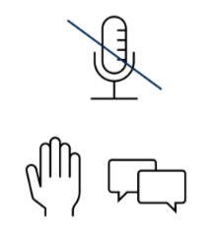

Housekeeping
Mute yourself and turn-off the camera when not speaking.
Raise your hand or write in the chat for any interventions/questions. Please state your name and affiliation before speaking.
Please note that this meeting will be recorded for documentation purposes. By remaining in the meeting, participants acknowledge that the session is being recorded.

Slide 4
Agenda
Time | Topic | Duration | Presenter
09.30-09.35 | Welcome | 5 min | DG ENV
09.35-09.40 | Introduction | 5 min | VITO
09.40-09.45 | Introduction to the study team | 5 min | Trinomics
09.45-09.55 | Introduction to the study | 10 min | Trinomics & Oeko-Institute
09.55-10.35 | Task 1- Scope | 40 min | Oeko-Institute
10.35-10.50 | Coffee-Break | 15 min
10.50-11.30 | Task 2- Market | 40 min | Trinomics
11.30-12.10 | Task 3- Users | 40 min | Oeko-Institute
12.10-13.25 | Lunch Break | 75 min
13.25-13.40 | LCA Findings | 15 min | Ecoinnovazione
13.40-14.20 | Task 4 -Technologies | 40 min | Oeko-Institute
14.20-14.35 | Coffee-Break | 15 min
14.35-15.20 | Base Cases | 45 min | Ecoinnovazione & Oeko-Institute
15.20-15.50 | DPP Aspect | 30 min | Fraunhofer IZM
15.50-16:00 | Closing words and next steps | 10 mins | Trinomics & Oeko-Institute

Slide 5

Welcome
By DG Environment
Kathrin Kutlescha & Jana Hrckova

Slide 6
Introduction to ESPR

Slide 7
Building on ecodesign and energy labelling
Two instruments that have shaped the EU product market for over 15 years
Efficiency
PUSH
Ecodesign Directive (2009/125/EC)
Sets minimum requirements for energy-related products only. Products that do not meet them cannot be placed on the EU market. Now repealed and replaced by the ESPR.
A
B
PULL
C
D
PULL
Energy Labelling (Regulation (EU) 2017/1369)
A mandatory A–G label makes performance visible, steering consumers and manufacturers towards the best products.
E
F
Minimum requirement
G
PUSH
Banned from the EU market
LEGAL BASIS
Article 114 TFEU (internal market)
Harmonised rules that apply to all products placed on the EU market, whether made in the EU or imported
Source: European Commission (DG ENV), ESPR introduction, tyres stakeholder meeting, October 2025

Slide 8
A proven instrument
Ecodesign and energy labelling have transformed everyday products
Household lamps
Laundry dryers
Washing machines
1990
12
2020
100
1990
270
2020
150
1990
350
2020
96
lm/W
Light output per Watt
kWh/year
75% of sales now heat pump dryers
kWh/year
Water use down from 94 to 36 litres per cycle
75%
Impact on consumer choices
€209
Estimated savings per household, per year
–9%
Estimated GHG savings, all measures combined
Source: European Commission, Ecodesign Impact Accounting reports, as presented by DG ENV (October 2025)

Slide 9
ESPR: what’s new?
Regulation (EU) 2024/1781, in force since June 2024
DEFINITION (ART. 2(6)) ‘Ecodesign’ means the integration of environmental sustainability considerations into the characteristics of a product and the processes taking place throughout the product’s value chain.
ART. 1
Broader scope
A framework for almost all physical goods placed on the EU market, not only energy-related products. Exclusions include food, feed, medicines and vehicles.
ART. 4–6
New sustainability aspects
Product-specific delegated acts can set performance requirements, for example on durability, carbon footprint and recycled content.
ART. 7, 9–15
Strong focus on information
Information requirements and a Digital Product Passport, plus labels, to inform buyers, repairers and recyclers.
ART. 23–25, 65
And more
Ban on destroying unsold apparel and footwear, Green Public Procurement criteria, horizontal measures and market surveillance.
KEY PRODUCT ASPECTS FOR ECODESIGN REQUIREMENTS (ART. 5 AND ANNEX I)
Durability
Reliability
Reusability
Upgradability
Reparability
Maintenance & refurbishment
Substances of concern
Energy use & efficiency
Resource use & efficiency
Water use & efficiency
Recycled content
Possibility of remanufacturing
Possibility of recycling
Recovery of materials
Environmental footprint
Waste generation

Slide 10
ESPR: the process
A multi-staged process with stakeholder consultation at every step
ESPR Working Plan
Art. 18
Preparatory study & IA
MEErP + Better Regulation
Ecodesign Forum
Art. 19
Delegated act adopted
Art. 4
Measure applies
Stakeholder input collected throughout. Delegated acts are adopted by the Commission, subject to scrutiny by the European Parliament and the Council
FROM PREPARATORY STUDY TO DELEGATED ACT
WE ARE HERE
Preparatory study
Tasks 1–4: scope, markets, users, technologies
1st stakeholder meeting
Preparatory study
Tasks 5–7: environment & economics, design options, scenarios
2nd stakeholder meeting
Final preparatory study
Draft working documents
Consultation Forum
Impact assessment
Call for evidence & public consultation
Delegated act(s)
ESPR / MEErP methodology
Better Regulation toolbox

Slide 11

Introduction of the Study Team
Nele Kelchtermans -VITO

Slide 12





Tour de Table
Flemish Institute for Technological Research
> 1300 employees
HQ in Belgium
Energy research embedded in the EnergyVille research collaboration
Coordinated several Ecodesign FWC for DG ENER, DG GROW and DG ENV
Coordinator of the FWC
under which the study
has been contracted
Tatiana Pasquel Garcia
Contract Manager
Nele Kelchtermans
Deputy Contract Manager
Wai Chung Lam
Senior researcher

Slide 13

Project team and partner structure
FRAMEWORK CONTRACT
FWC management team
FWC contract manager Carolin Spirinckx
Deputy FWC contract manager Tatiana Pasquel Garcia
CLIENT
EC DG ENV
European Commission
DG Environment
PROJECT CONSORTIUM
CONTRACT LEAD
VITO
Contract manager Tatiana Pasquel Garcia
Deputy Nele Kelchtermans, Wai Chung Lam
PARTNER
Ecoinnovazione
Team leader Alessandra Zamagni
Senior experts Alessandra Zamagni, Lorenzo Tosti
Junior staff Christian Fontana, Dario Masoni
TECHNICAL LEAD
Trinomics
Technical team leader | Deputy
K. Afrodit Adsal | Corina Haita-Falah
Senior experts
Rob Williams, Timea Pal, Matthew Smith, Irati Artola
Experts
Corina Haita-Falah
Junior staff
Maja Lardot, Sara Svensson, Lucia van den Boogaart, Finn Goodall
PARTNER
Oeko-Institut
PS team leader Daniel Hinchliffe
Ecolabel Kathrin Graulich / Clara Löw
Senior experts Katja Moch, Clara Löw, Kathrin Graulich
Expert Ashleigh McLennan, Angela De Rose
Junior staff Sarah Lauterwald
PARTNER
Fraunhofer IZM
Team leader / Senior expert Eduard Wagner
Expert Theresa Aigner

Slide 14










Tour de Table
Trinomics BV
Founded 2012, ca. 60 employees
HQ in the Netherlands (Rotterdam), offices in Brussels + Paris
Circular Economy, environment, climate and energy consultancy
>95% of turnover with public entities or non-profit foundations
Extensive track record of policy support to European Commission (ENV, CLIMA, ENER, GROW, REFORM) and EEA: Evaluations, IAs, studies
Led IA study for Sustainable Products Initiative (SPI)
Project lead
MEErP Task 2 Markets, 6 Design options, 7 Policy Options
Lead of impact assessment
K. Afrodit Adsal
SR12 Project Manager / Senior Consultant
Dr. Corina Haita-Falah
Expert /Deputy Project Manager
Rob Williams
Senior consultant
Irati Artola
Senior consultant
Matthew Smith
Senior consultant
Dr. Timea Pal
Senior consultant
Lucia van den Boogaart ​
Junior expert
Maja Lardot​
Junior expert
Sara Svensson​
Junior expert
Finn Goodall​
Junior expert

Slide 15






Tour de Table
Oeko-Institut, Institute for Applied Ecology
Founded in 1977, > 200 employees, based in Germany
Research on sustainable products & material flows, resources, circular economy & global value chains, energy & climate, chemicals, environmental law & governance, ...
Several product policy projects for DG ENV, ENER and GROW
(SPI, Ecodesign, Energy label, EU Ecolabel, GPP, REACH, RoHS, ELV, Batteries, Green Claims etc.)
Product category Furniture under FWC ESPR SR7 study
Methodological experts (MEErP/ERT, PEF/PEFCR, LCA/LCC, evaluations, impact assessments)
Lead of Preparatory Study; responsible for MEErP Tasks
1 (Scope), 3 (Users), 4 (Technology), 5 (SoC), Lead of Working Document and involvement in the impact assessment
Daniel Hinchliffe
Preparatory Study Team Lead & Senior Researcher
Dr. Angela De Rose
Preparatory Study Team Co-Lead; Expert
Ashleigh McLennan
Preparatory Study Team Co-Lead; Expert
Kathrin Graulich Ecolabel Team Lead
& Senior Researcher
Clara Löw
Ecolabel Team-Co Lead & Senior Researcher
Sarah Lauterwald
Junior Expert

Slide 16




Tour de Table
Sustainability research and consultancy, founded in 2012 as ENEA spin-off.
16 team members, located in Bologna, Italy
Specialised in life cycle-based sustainability assessment, LCA, EF, Social LCA, ecodesign, stakeholders’ engagement, LCC, development of LCI datasets and databases, critical reviews
International clients, EU+USA+UNIDO and CDP
Involvement in several networks at EU and international level (member of TAB in the transition phase, UN Life Cycle Initiative, Social Alliance, the Italian LCA network)
Involved in several projects with DG GROW and DG ENV for the development and review of datasets for different policies (including ESPR)
Responsible for MEErP Tasks
5 (LCA)
Alessandra Zamagni
Scientific Director,
Team leader/Senior Expert
Lorenzo Tosti
Senior Expert
Christian Fontana
Junior Expert
Dario Masoni
Junior Expert

Slide 17


Tour de Table
Fraunhofer IZM (Institute for Reliability and Microintegration) / Department Environmental and Reliability Engineering
Founded in 1993, >460 employees
Fraunhofer IZM has been involved in various ecodesign related studies, including preparatory and impact assessments studies.
In recent years Fraunhofer IZM takes a leading role in the development of the digital product passport for the European Commission (CIRPASS, CIRPASS2).
Responsible for DPP aspect
Dr. Eduard Wagner
Senior expert
Theresa Aigner
Expert

Slide 18

Introduction to the ESPR Preparatory Study on Furniture

Slide 19
Background: why furniture, why now
Furniture is among the first product groups under the ESPR Working Plan
ESPR context
Regulation (EU) 2024/1781 extends ecodesign beyond energy-related products, enabling performance and information requirements for almost all physical goods placed on the EU market.
THE EU FURNITURE MARKET AT A GLANCE
€76.6 bn
EU production value (2024)
~125,000
manufacturers, 92% of them micro-enterprises
A priority product group
Large EU market with significant improvement potential in material efficiency, waste generation, recycled content and end-of-life management.
ESPR Working Plan 2025–2030
Furniture is among the first product groups to be addressed, with adoption of a delegated act indicatively targeted for 2028.
~6.7 bn
furniture items in use in the EU (2024 estimate)
~€20 bn
extra-EU imports and exports, each (2024)
This preparatory study
Provides the technical, environmental, market and user evidence to assess possible performance and information requirements, including a Digital Product Passport.
Source: interim Task 1–4 report (draft, September 2026)

Slide 20
One contract, three connected workstreams
ESPR preparatory study, EU Ecolabel revision and a possible impact assessment
ONGOING
Mar 2026 – Spring 2027
ESPR preparatory study
▪ Follows MEErP Tasks 1–7, extended with the JRC’s new ESPR methodologies.
▪ Phase I (Tasks 1–4): scope, markets, users and technologies.
▪ Phase II (Tasks 5–7): environment and economics, design options and scenarios.
ONGOING IN PARALLEL
Same study team
EU Ecolabel criteria revision
▪ Revision of the EU Ecolabel criteria for furniture (Decision (EU) 2016/1332).
▪ Run in parallel with the ESPR work to make use of synergies.
▪ Own stakeholder survey held in June–July 2026.
SUBJECT TO COMMISSION DECISION
Following the study, ending May 2028
Impact Assessment support study
▪ Launched if the Commission decides to develop a draft ESPR delegated act for furniture.
▪ Builds on the intervention logic developed during the preparatory study.
Shared approach: the same consortium carries out the ESPR study and the EU Ecolabel revision, making use of synergies in evidence and stakeholder input.

Slide 21
What the study covers
Scope of work and key challenges
LCA data and impacts
Mapping of available LCA data and environmental impacts
Product design aspects
Design complexity, recyclability, durability and substances of concern
01
02
KEY CHALLENGES
Granularity and proportionality
Defining product requirements for a highly heterogeneous product group.
Methodological alignment
Bringing together MEErP, PEF, the EcoReport tool and the DPP.
Mandatory and voluntary instruments
Balancing ESPR requirements and the EU Ecolabel.
Intervention logic
Coherence with the new ESPR methodologies
EU Ecolabel
Revision of the EU Ecolabel criteria for furniture
03
04
Digital Product Passport
Definition of requirements for the DPP
Stakeholder consultation
Consultation and synthesis of feedback
05
06

Slide 22
Timeline
Today’s meeting is the first stakeholder milestone of the study
WE ARE HERE
12 Mar 2026
Study start
Apr–May 2026
Online platform, questionnaire and consultation on Tasks 1⁠–⁠4
Aug 2026
Interim draft Task 1–4 reports for comments
6 Oct 2026
1st stakeholder meeting on Tasks 1⁠–⁠4
Feb 2027
Interim draft Task 5–7 reports for comments
Mar 2027
2nd stakeholder meeting on Tasks 5⁠–⁠7
Spring 2027
Final preparatory study
2027 – May 2028
Impact Assessment support study, if decided by the Commission
WORK PHASES
Phase I: MEErP Tasks 1–4
Phase II: MEErP Tasks 5–7
EU Ecolabel criteria revision (in parallel)
Impact Assessment support (conditional)
Planned dates are tentative. Latest planning: espr-euecolabel-furniture.eu/project-plan

Slide 23
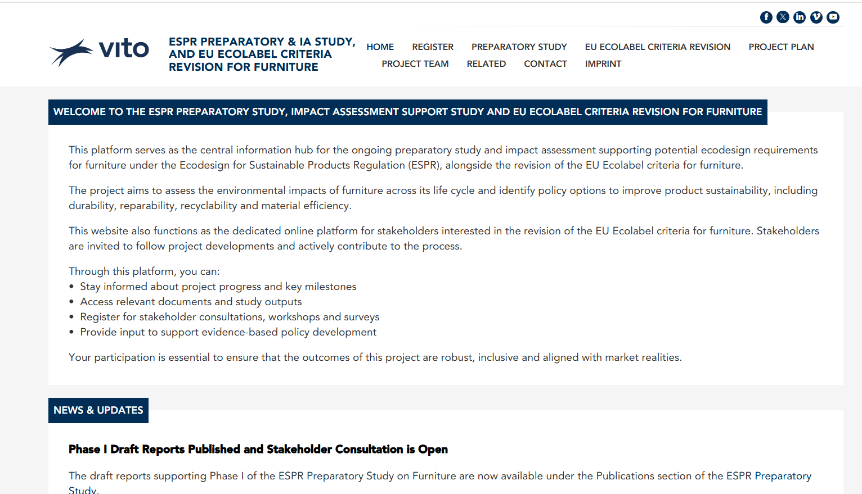
Project website
https://espr-euecolabel-furniture.eu/
Only registered stakeholders get informed!
➔ Register!

Slide 24
Preparatory study: Methodology
MEErP: OVERVIEW
Task 1
Scope
Task 2
Markets
Task 3
Users
Task 4
Task 5
Task 6
Task 7
Technologies
Environment
Economics
Design options
Scenarios
Task 1 - Scope
(definitions, standards and legislation, 1st screening)
Task 2 – Markets
(volumes and prices)
Task 3 – User
(product demand side)
Task 4 - Technologies
(product supply side, includes both Best Available Technology (BAT) and Best Not Yet Available Technology (BNAT)
Task 5 – Environment & Economics
(Life Cycle Analysis (LCA) & Life Cycle Costing (LCC) of the Base Cases)
Task 6 – Design options
to improve LCA + LCC;
Task 7 – Scenarios
(Policy, scenario, impact and sensitivity analysis)
Definition of Base Cases (BC) representing the average product on the market in terms of resources efficiency, emissions and functional performance

Slide 25
What are base cases?
In the context of the Ecodesign for Sustainable Products Regulation (ESPR), a base case is a reference scenario, or a “typical product” used as a benchmark when assessing the environmental impacts, energy efficiency, or other sustainability features of a product group.
Similar to a business as usual scenario, base cases allow potential improvements of policy options to be compared against a common, widely available product.
This further helps in the quantification of impacts of proposed ESPR requirements
Base cases can be chosen based on market share, average performance of certain parameters or data availability
For furniture this is particularly challenging:
  1000s of product types
  1000s of material compositions
  Market data granularity: “Kitchen furniture”

Slide 26
Preparatory study: Methodology
MEErP: OVERVIEW
Task 1
Scope
Task 2
Markets
Task 3
Users
Task 4
Task 5
Task 6
Task 7
Technologies
Environment
Economics
Design options
Scenarios
Task 1 – Scope
Task 2 – Markets
Task 3 – User
Task 4 – Technologies
Task 5 – Environment & Economics
Task 6 – Design options
Task 7 – Scenarios
today’s stakeholder meeting
+base cases
stakeholder meeting 2

Slide 27
Preparatory study: Methodology
Research and data collection on markets, users, and technologies
(Task 2-4 )
Define Design Options
(Task 6)
Scoping
(Task 1)
Determine policy options and estimate their impact
(Task 7)
Base Cases
Life Cycle Assessment (LCA based on PEF*) and Life Cycle of Costing (LCC) to calculate environmental and economic parameters
(Task 5 )
Calculate environmental and economic parameters for Design Options
(Task 6)
* Product Environmental Footprint

Slide 28
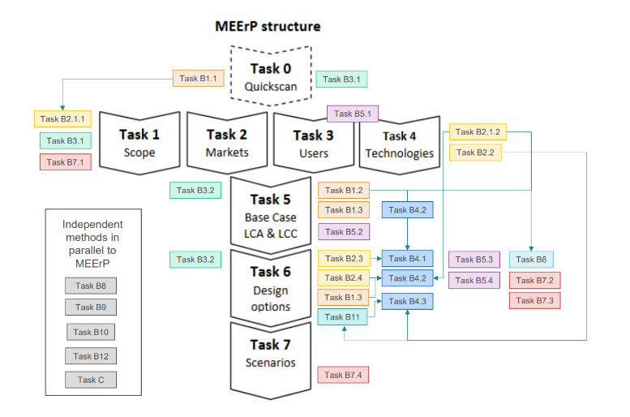
MEErP methodology: revised for the purposes of the ESPR
Methodology for Ecodesign of Energy related Products
  Methodologies for ESPR aspects
Additional Elements to MEErP
Method for the assessment of product aspects in view of ecodesign requirements under ESPR (JRC143215)
Methods for the definition of classes of performance and labels (JRC143463)
Method for the identification and tracking of substances of concern in products and for the preparation of restriction measures on the use of substances in products (JRC143683)
Method for the ranking of potential requirements based expected impacts and costs (JRC143331)
Methodology for defining data requirements for the Digital Product Passport under the ESPR framework (JRC145830)
Method for the integration of the support to ESPR impact assessments within the evaluation process of products, including international trade aspects and impact of measures on third countries (JRC142690)
Method for the definition of mandatory Green Public Procurement requirements (JRC145122)
Method for the assessment of EU Open Strategic Autonomy aspects in the context of the Ecodesign for Sustainable Products Regulation (JRC143215)
Method for the assessment of circularity aspects and integration in or relation with the Methodology for the Ecodesign of Energy-related Products (MEErP) (JRC143211)
Image elaborated by JRC, B numbers correspond to methodologies.

Slide 29
Tasks 1-4
Task 1: Scope
  Highly heterogenous product group, scope definition will be extremely important
  Different ways to do this:
    by function (sitting, lying, surface, storage),
    by type (office, home, chair, table etc.),
    by material composition (wooden, metal, plastic etc.).
  Can draw on experiences/align with labelling and standards schemes, will inform base case development.
Task 2: Markets
  Limited datasets available in past, likely that certain data sets not easily available (e.g. lack of EPR schemes), granularity between specific furniture types in Prodcom to be assessed.
  Data availability defines scope possibilities for the modelling.
Task 3: User behaviour
  Available data in the literature will be researched, but likely to be some gaps between stated actions and taken actions from consumers.
  Will possibly need to be creative to determine real-world behaviours, actionability of ESPR label.
Task 4: Technologies
  Gather information on different lifecycle steps to inform PEF modelling.
  In T5 will be necessary to attempt to define "average" furniture pieces that can support the base case modelling. E.g.: individual furniture items, by function, or a chair by percentage of materials contained on the market. Also complete an SoC inventory.

Slide 30
Preparatory Study: MEErP Task 1

Slide 31
Objectives of MEErP Task 1
MEErP: Methodology for Ecodesign
of Energy-related Products
ESPR: Ecodesign for Sustainable
Products Regulation
Defining the product category and the system boundaries of the ‘playing field’ for ecodesign and ESPR Legislation¹
Determine potential scope for the study
First look at definitions and exemptions
Identify relevant legislation on furniture, Ecolabels and test standards across EU
Apply initial ESPR aspect filtering
Important as determines focus of the rest of the study
¹Regulation (EU) 2024/1781 of the European Parliament and of The Council, 2024, establishing a framework for the setting of ecodesign requirements for sustainable products, OJ L 2024/1781, 28.6.2024

Slide 32
Task 1 - Scope
JRC: Joint Research Center
(science and knowledge service
of the European Commission)
Product scope, definition and boundaries – Definition of “furniture”
Preliminary conclusion that the existing definition by EU Ecolabel¹ & JRC² (and their exclusions) should be used i.e.
EPR scheme definitions (in development)
France & the Netherlands: explicit functional definition comparable to this wording but different exclusions
Hungary: material-based definition (specifically “wood”) instead of functional definition
Spain & Portugal: no definition available
“[…] free-standing or built-in units whose primary function is to be used for the storage, placement or hanging of items and/or to provide surfaces where users can rest, sit, eat, study or work, whether for indoor or outdoor use.[…] Bed frames, legs, bases and headboards are included in the scope […]”
¹Comission Decision (EU) 2016/1332 establishing the ecological criteria for the award of the EU Ecolabel for furniture
²Faraca et al., Ecodesign for Sustainable Products Regulation: Study on new product priorities, JRC, 2024

Slide 33
Task 1 - Scope
Product scope, definition and boundaries – Exclusions^{1,2}
Bed mattresses, streetlights, railings and fences, ladders, clocks, playground equipment, stand-alone or wall-hung mirrors, electrical conduits, road bollards and building products such as steps, doors, windows, floor coverings, cladding
Second-hand, refinished, refurbished, remanufactured furniture products
Furniture fitted in vehicles
Ecolabel also excludes Furniture products which consist of > 5 %_{wt.} of materials not included in this list
-> possibly these also relevant under scope of potential horizontal requirements under ESPR.
solid wood, wood-based panels, cork, bamboo, rattan, plastics, metals, leather, coated fabrics, textiles, glass and padding/filling materials
Q1-1: Should “built-in” or “bespoke units” be included within the scope for furniture? If “built-in units” should be excluded in your opinion, what would be the best approach for doing so? What potential loopholes could be created by the exclusion of “built-in units” and how could this be mitigated?
Q1-2: To what extent do you agree with additional exclusions beyond those made in the JRC definition? Do you believe further exclusions are necessary?
¹Comission Decision (EU) 2016/1332 establishing the ecological criteria for the award of the EU Ecolabel for furniture
²Faraca et al., Ecodesign for Sustainable Products Regulation: Study on new product priorities, JRC, 2024

Slide 34
Task 1 - Scope
REACH: Regulation on Registration, Evaluation,
Authorization and Restriction of Chemicals
CLP: Classification, Labelling and Packaging of
substances and mixtures
GPSR: General Product Safety Regulation
PPWR: Packaging and Packaging Waste Regulation
WFD: Waste Framework Directive
EPR: Extended Producer Responsibility
EUDR: EU Deforestation Regulation
TLR: Textile Labelling Regulation
CPR: Construction Products Regulation
BPR: Biocidal Products Regulation
CITES: Convention on International Trade in Endangered
Species of Wild Fauna and Flora
POPs: Stockholm Convention on Persistent Organic Pollutants
Relevant national & international legislation
Hazardous properties of chemicals
EU
legal acts
Chemicals
Trade
International legal acts
CLP 1272/2008/EC
Materials
Biocidal products
REACH 1907/2006/EC
CITES
POPs
BPR No. 528/2012, Art. 58
Furniture sector
Deforestation
EUDR 2023/1115/EU
Right to repair dir. 2024/1799/EU
Reparability
GPSR 2023/988/EU
Packaging Dir. 94/62/EC
& PPWR 2025/40/EU
Reuse of waste
Product safety
CPR 2024/3110/EU
WFD 2008/98/EC, incl. EPR
TLR 1007/2011/EU
Performance & safety of construction products
Waste management
Labelling of compositions

Slide 35
Task 1 - Scope
REACH: Regulation on Registration, Evaluation,
Authorization and Restriction of Chemicals
CLP: Classification, Labelling and Packaging of
substances and mixtures
GPSR: General Product Safety Regulation
PPWR: Packaging and Packaging Waste Regulation
WFD: Waste Framework Directive
EPR: Extended Producer Responsibility
EUDR: EU Deforestation Regulation
TLR: Textile Labelling Regulation
CPR: Construction Products Regulation
BPR: Biocidal Products Regulation
CITIES: Convention on International Trade in Endangered
Species of Wild Fauna and Flora
POPs: Stockholm Convention on Persistent Organic Pollutants
Relevant national & international legislation
Hazardous properties of chemicals
EU
legal acts
Chemicals
Trade
International legal acts
Relevant MS legislation > EPR schemes:
  France
  Hungary (wooden furniture, since 2023)
  Spain (under development)
  Portugal (under development)
  The Netherlands (under development)
  Italy (voluntary, under development)
CLP 1272/2008/EC
Materials
Biocidal products
REACH 1907/2006/EC
CITIES
POPs
BPR No. 528/2012, Art. 58
Furniture sector
Deforestation
EUDR 2023/1115/EU
Right to repair dir. 2024/1799/EU
Reparability
GPSR 2023/988/EU
Packaging Dir. 94/62/EC
& PPWR 2025/40/EU
Reuse of waste
Product safety
CPR 2024/3110/EU
WFD 2008/98/EC, incl. EPR
TLR 1007/2011/EU
Performance & safety of construction products
Waste management
Labelling of compositions
EPR: Extended Producer Responsibility

Slide 36
Task 1 - Scope
Legislation screening
The following EU & international legal acts were identified as relevant to the furniture sector:
  REACH Regulation 1907/2006/EC
  CLP Regulation 1272/2008/EC
  General Product Safety Regulation (GPSR) 2023/988/EU
  Packaging Directive 94/62/EC & Packaging and Packaging Waste Regulation (PPWR)
  Waste Framework Directive 2008/98/EC
  Deforestation Regulation 2023/1115/EU
  Textile Labelling Regulation 1007//2011/EU
  Right to Repair Directive 2024/1799/EU
  Construction Products Regulation (CPR) 2024/3110/EU
  Biocidal Product Regulation (EU) No 528/2012
  Convention on International Trade in Endangered Species
  of Wild Fauna and Flora (CITIES)
  Stockholm Convention on Persistent Organic Pollutants (POPS)
Relevant MS legislation > EPR schemes:
  France
  Hungary (wooden furniture, since 2023)
  Spain (under development)
  Portugal (under development)
  The Netherlands (under development)
  Italy (voluntary, under development)
Please check this list. Is something relevant missing here?
Notes:
In a previous version, the Environmental Taxonomy Regulation 2020/852/EU was also listed.

Slide 37
Task 1 - Scope
Test standards
Criteria for test standards for furniture: safety, strength, stability, durability
  Goal: harmonized European baseline
~85 EN or ISO/IEC standards
National standards which do not exist at European level
  Germany: 6 DIN standards
  Italy: ~40 UNI standards
Standards for circularity
  Only one standard published to date:
  EN 17902:2023 (¹)
  Three standards are under development
Question: check Tables 5-3 to 5-5 in Sec. 5.4. of Draft Report T1. Is something relevant missing?
¹EN 17902:2023, Furniture – Circularity – Evaluation method for dis/re-assembly capability, published by WG 10 of CEN/TC 207

Slide 38










Task 1 - Scope
Voluntary schemes
EU / National voluntary schemes
EU Ecolabel
EU Green Public Procurement (GPP) criteria
Nordic Swan
Blue Angel
Austrian Ecolabel
FEMB Level Certification
German Furniture Quality Association (DGM): Golden M
Möbelfakta
Cradle to Cradle Certified®
Marque NF and NF Ameublement family
Stichting Inkoop Platform
Third country voluntary schemes
BIFMA LEVEL®
Question: Is anything relevant missing here?

Slide 39






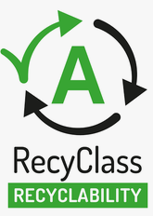






Task 1 - Scope
Voluntary schemes – material-related certifications
Wood
FSC (Forest Stewardship Council)
PEFC (Programme for the Endorsement of Forest Certification)
Bois de Frane
STIP (Stichting Inkoop Platform)
Textiles
OEKO-TEX
GOTS (Global Organic Textile Standard)
ERTS (Ecological and Recycled Textile Standard)
GRS (Global Recycled Standard)
RCS (Recycled Claim Standard)
Latex foam
GOLS (Global Organic Latex Standard)
PU foam
ISCC+ (International Sustainability and Carbon Certification)
Plastics (recycled content)
RecyClass
MPR (Incorporation de Matières Plastiques Recyclées)
Question: Is something relevant missing here?

Slide 40




Task 1 - Scope
Voluntary schemes
Chemical- and emission-related certifications
CARB (California Air Resources Board)
CertiPUR®
Greenguard (Gold)
Solar Impulse Efficient Solutions Label
Question: Is something relevant missing here?

Slide 41
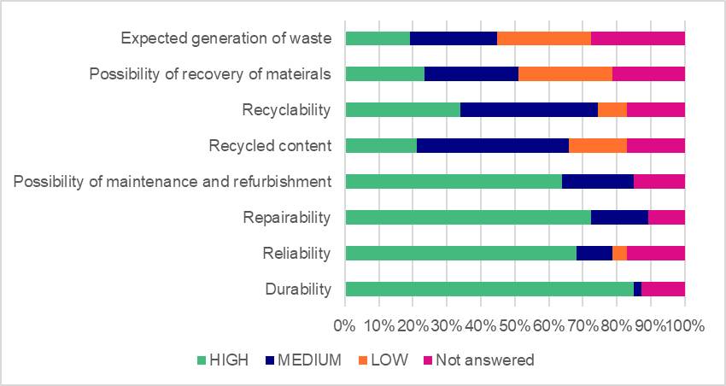
Task 1 - Scope
Assessment of circularity relevance (acc. JRC method, Rodriguez et al.)¹
Filtering of relevant circularity aspects relevant to “complex, durable product” according to JRC
B2 methodology. Validated through stakeholder survey.
Low
Relevance
High
Priority of circularity aspects to aspects of ecodesign according to stakeholder survey (n=44)
¹Rodriguez et al., Method for the assessment of circularity aspects and integration in or relation with the Methodology for the Ecodesign of Energy-related Products (MEErP), JRC143212, DOI: 10.2760/4572606, 2025

Slide 42
Task 1 - Scope
Standards
Test methods
Voluntary schemes
Assessment of circularity relevance (acc. JRC method, Rodriguez et al.)¹
Circularity standards under development in WG10
Circularity aspect cluster
Product specific standards relating to safety, strength and durability
Circularity standards under development in WG10
Seating: EN 1728:2012/CA:2013
FEMB Levels
Storage: EN 16122:2012/AC:2015
Repairability & possibility
of maintenance
Durability & reliability
Blue Angel
Tables: EN 1730:2012
EU Ecolabel
Blue Angel
Nordic Swan
Golden M
Recyclability, possibility of
recovery of
materials & recycled content
Upgradeability & modularity / design-for-disassembly
Nordic Swan
Nordic Swan
FEMB Levels
FEMB Levels
Circularity standard: EN 17902:2023
Circularity standards under development in WG10
¹Rodriguez et al., Method for the assessment of circularity aspects and integration in or relation with the Methodology for the Ecodesign of Energy-related Products (MEErP), JRC143212, DOI: 10.2760/4572606, 2025

Slide 43
Task 1 - Scope
Overview on questions to stakeholders
Q1-1: Should “built-in” or “bespoke units” be included within the scope for furniture.
  If “built-in units” should be excluded in your opinion, what would be the best approach for doing so? What potential loopholes could be created by the exclusion of “built-in units” and how could this be mitigated?
Q1-2: To what extent do you agree with additional exclusions beyond those made in the JRC definition?
  Do you believe further exclusions are necessary?
Q1-3: Of the standards and labels listed in Table 5-10*, which standards or voluntary labels provide the most suitable basis for defining and measuring circularity?
  Are there further means to define and measure the circularity aspect clusters which the study team should be aware of?
Please check our tables & lists for legislation, test standards and voluntary schemes and come back to us if s.th. relevant is missing.
*see Table 5-10 on page 130 f. in Section 5.8 of draft report version 1 for phase 1 of preparatory study on ecodesign for furniture (Sept. 2026)

Slide 44
Coffee Break – 15 min
Please be back at 10:50

Slide 45
Preparatory Study: MEErP Task 2

Slide 46
Objectives of MEErP Task 2
Characterise the EU furniture market: market size, production, trade, apparent consumptions
Identify the most market-relevant furniture segments
Assess the geographical structure of the market: key producing MSs
Examine market trends: consumer preferences, purchasing behaviour, and product design developments.
Evaluate circular economy aspects: EPR schemes; repairability ecosystems and repair services; reuse, resale, refurbishment, and remanufacturing channels
Provide a comprehensive understanding of the furniture market and the evidence base that informs the development of product base cases (Task 5) and the formulation of the design options (Task 6).

Slide 47
Task 2: Markets
€ 76.9 bn
EU-27 sold production in 2024
Kitchen furniture: € 14.4 bn or 80.8 mil units
Growth is nominal, not real 2015-2024
+1.7% nominal CAGR -1.1% real CAGR
kitchen furniture: the only category with positive real growth.
Highly fragmented manufacturing 2024
125,000
manufacturing enterprises
92% micro-enterprises
Production concentration: Italy • Poland • Spain • (Germany, France)
Employment concentrated in: Germany • Poland • Italy • Spain
SMEs employ 53% for employees in the sector
Trade exposure differs by product
Extra-EU imports as share of apparent consumption (based on EUR, 2024)
Raw material exposure
Parts of seats | 58%
Metal furniture | 52%
Other wooden furniture | 29%
Upholstered seats (wooden frames) | 28%
Wooden bedroom | 20%
Wooden dining & living | 16%
Parts of furniture (wood n.e.s.) | 5%
Kitchen furniture | 1%
Shares of not-EU imports in apparent consumption of wood-based intermediates (based on m³, 2024)
Plywood
44%
Main source-country exposure
Ukraine: sawnwood, veneer, PB/OSB
Türkiye: fibreboard
China & Brazil: plywood
Veneer
37%
Fibreboard
8%
Sawnwood
6%
Extra-EU imports by MSs: Germany • France • Netherlands
Extra-EU exports by MSs: Poland • Germany • Italy
Third-country imports: China • Vietnam • Türkiye • Ukraine • Indonesia • Serbia
PB / OSB
4%
Notes:
Micro – 0 to 9 employees, SMEs – 10 to 24 ; 7% SMEs in manufacturing
PB=Particle board, OSB=oriented strandboard

Slide 48
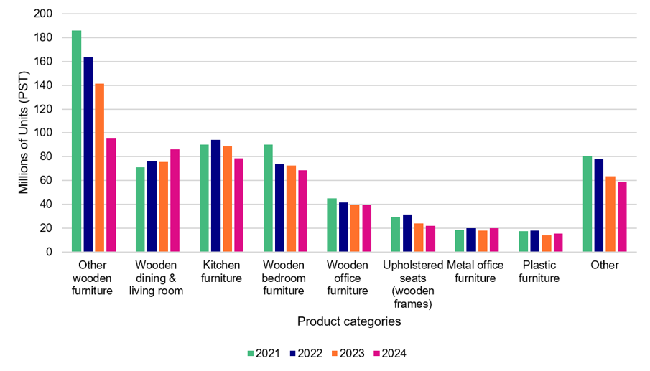
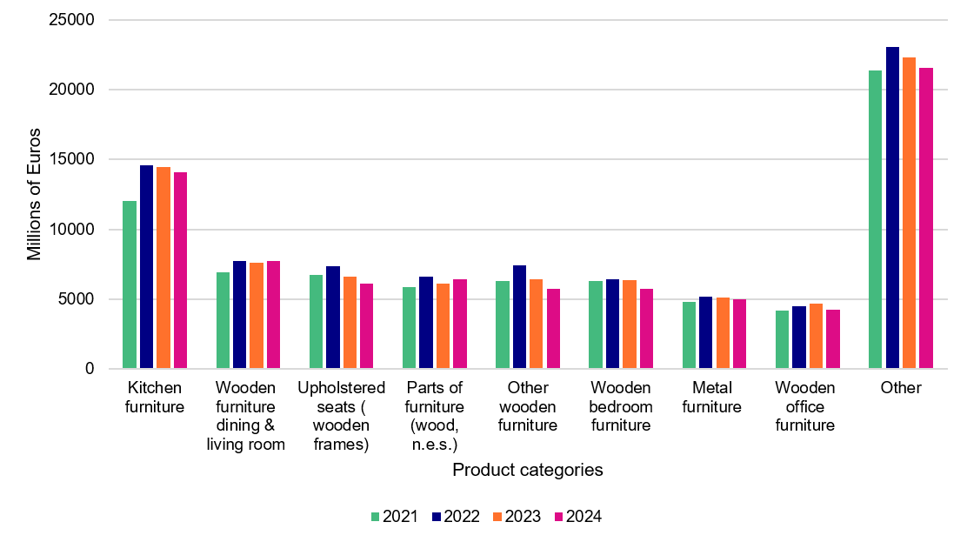
Task 2: Markets
EUR 76.6 bn
484 mil pieces
630 mil kg
Total production value, 2024
Physical production, PST
Other metal furniture
Production
Top product categories by quantity (EU-27, 2024)
Top product categories by value (EU-27, 2024)
Product | mil pieces
Other wooden furniture | 95.0
Dining & living room (wood) | 86.0
Kitchen furniture | 78.8
Bedroom furniture (wood) | 68.7
Office furniture (wood) | 39.5
Product | EUR bn
Kitchen furniture | 14.1
Dining & living room (wood) | 7.7
Furniture parts (wood) | 6.4
Upholstered seats (wood frame) | 6.1
Other wooden furniture | 5.7
Main findings
Production is concentrated in a few broad wood-based categories, but the ranking differs between physical output and value.
Production concentration: Italy; Poland; Spain; Lithuania, Portugal, the Netherlands, Romania
PST production fell 23% from 2021 to 2024, while total production value was relatively more stable.

Slide 49
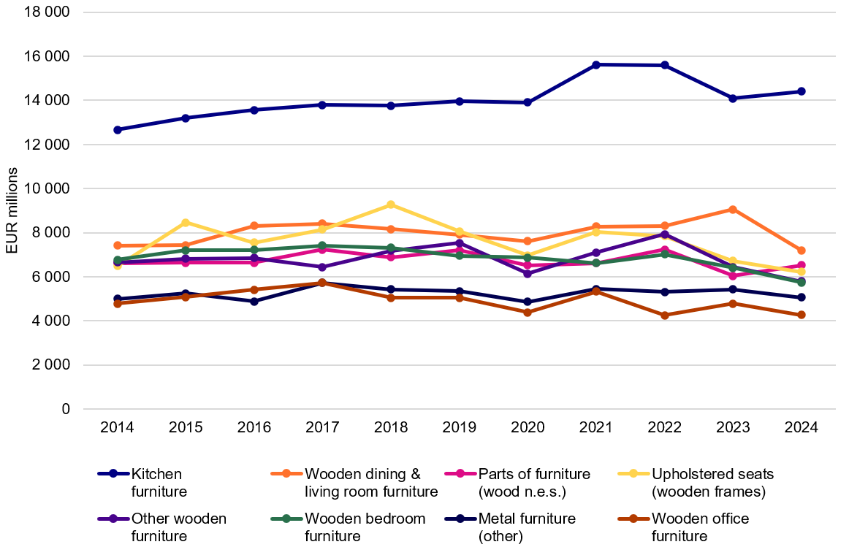
Task 2: Markets
EUR 76.9 bn
457.5 m PST
Sales and apparent consumption
Sold production value, 2024
Sold production, PST
Top sold production by qnty (2024)
Top sold production by value (2024)
Product | m pieces
Other wooden furniture | 94.8
Kitchen furniture | 80.8
Bedroom furniture (wood) | 68.9
Dining & living room (wood) | 50.0
Office furniture (wood) | 39.5
Product | EUR bn
Kitchen furniture | 14.4
Dining & living room (wood) | 7.2
Furniture parts (wood) | 6.5
Upholstered seats (wood frame) | 6.2
Other wooden furniture | 5.8
Sold production value, 2014–2024
(constant 2024 prices)
Largest apparent consumption categories (2024)
Product | EUR bn | Extra-EU import share
Kitchen furniture | 12.8 | 1.2%
Other metal furniture | 6.9 | 51.6%
Dining & living room (wood) | 6.8 | 16.0%
Upholstered seats (wood frame) | 5.6 | 27.6%
Furniture parts (wood) | 5.5 | 4.9%
Source: Eurostat PRODCOM DS-059358;
Apparent consumption = sold production − extra-EU exports + extra-EU imports.
Notes:
Main findings
Kitchen furniture is the largest sales category by value and second largest in PST.
Rankings differ between value and physical quantity
Apparent consumption shows low extra-EU import reliance for kitchen furniture and wood parts, but high reliance for other metal furniture
Limitations: Apparent consumption can only be calculated in value terms (EUR). For most of the furniture product codes considered, as Eurostat does not report import and export quantities in comparable units, as customs data generally record furniture trade by weight and value rather than by number of items. Apparent consumption in physical units can therefore not be estimated. As Eurostat also does not provide an aggregate total across all furniture product codes, the analysis focuses on the eight largest product categories by EU-27 sold production value in 2024.

Slide 50
Task 2: Markets
Trade
EUR 20.35 bn
Extra-EU exports, 2024
EUR 20.36 bn
Extra-EU imports, 2024
EUR 46.39 bn
Intra-EU exports, 2024
EUR 39.88 bn
Intra-EU imports, 2024
Extra-EU trade (PRODCOM)
Intra-EU trade (Comext)
Top extra-EU exports (2024)
Top extra-EU imports (2024)
Top intra-EU exports (2024)
Top intra-EU imports (2024)
Product
EUR bn
Product
EUR bn
Product
EUR bn
Product
EUR bn
Upholstered seats
(wood frame)
2.18
Other metal
furniture
3.54
Parts of seats
(not of wood)
8.57
Parts of seats
(not of wood)
9.24
Other wooden
furniture
1.98
Parts of seats
2.70
Other wooden
furniture
8.19
Other wooden
furniture
6.65
Kitchen furniture
1.75
Upholstered seats
(metal frame)
1.76
Upholstered seats
(wood frame)
4.79
Upholstered seats
(wood frame)
4.09
Extra-EU imports by MSs: Germany • France • Netherlands; Extra-EU exports by MSs: Poland • Germany • Italy;
Third-country imports: China • Vietnam • Türkiye • Ukraine • Indonesia • Serbia
Main findings
Intra-EU trade is larger than extra-EU trade, highlighting the importance of the internal market.
Extra-EU exports and imports are nearly equal in total value, but are concentrated in different product categories.
Intra-EU trade is led by parts of seats and other wooden furniture, while extra-EU imports are concentrated in metal furniture and seating components.
Notes:
Total intra-EU exports and total intra-EU imports should, in theory, cancel out. Eurostat itself flags this as a known issue with intra-EU trade data, caused by factors like different valuation methods, reporting thresholds for smaller traders, and estimates for missing data. These figures should be read as Eurostat's best estimates of each flow, not as perfectly matched statistics.

Slide 51
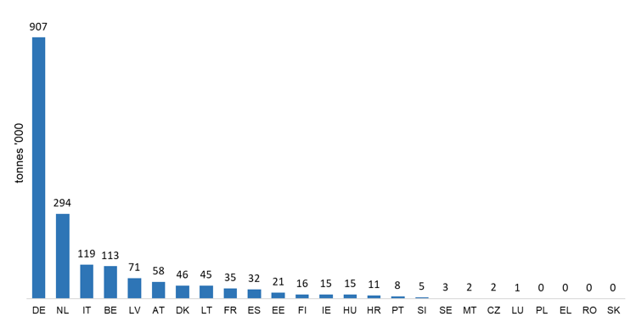
Task 2: Markets
Secondary market
~ EUR 39 bn in 2024*
54% online platforms
6 kg/capita
*Selected EU non-EU countries European (Market Data Forecast, 2026)
Average reported EU furniture reuse
Sales in physical shops / markets | Sales in online platforms | Other channels | Total
75 617 | 130 433 | 87 521 | 293 571
Secondary-market sales of furniture in the Netherlands (tonnes, 2024)
Source: Dutch Ministry of Economic Affairs and Climate via project’s stakeholder survey
Furniture reuse across the EU MSs (tonnes, reference year 2021)
Source: EEA, 2024, data reported pursuant to the implementing decision (EU) 2021/19
The secondary market ecosystem
PROs and EPR schemes: can finance collection, sorting, repair and refurbishment, and connect PROs with reuse operators. Dedicated schemes remain limited and uneven across MSs.
Repair: by professional and independent repairers, repair cafes and consumers. The sector is growing but remains fragmented and dominated by micro-enterprises (in 2024: 17 500 enterprises employing 27 000 persons, including self-employed and unpaid family members.)
Social enterprises: 1 163 social enterprises active in the EU (RREUSE)
Incentives to repair: repair bonuses and circular-economy subsidies can reduce costs and support repair activities, although coverage remains limited (France, Ireland, the Netherlands)
Refurbishment: concentrated in B2B and office furniture;
Remanufacturing: remains limited.
Market channels: Online platforms and social media are the main channels, complemented by shops, flea markets, charities, municipal reuse centres and professional refurbishers. Logistics and transport costs constrain the scale-up.
Notes:
The secondary market for furniture involves the re-sale of pre-owned furniture both in informal and official setting.
EPR scheme in France: Ecomaison (formerly known as Eco-mobilier), Valdelia, and Valo
1 163 social enterprises are active in EU countries, most of them in France (330 social enterprises) and Belgium (205 social enterprises)
Incentive to repair: Vienna Reparaturbon
Remanufacturing - The main reason for this, as cited by the stakeholders, is that remanufacturing can only take place in the original producer facility or an authorised one. An independent remanufacturer would need to comply with safety and intellectual property requirements.

Slide 52
Task 2: Markets
Structure of the sector
Wages (2023 data)
 | Micro | SME | Large
Wage bill | 2 627 EUR mil | 10 596 EUR mil | 7 034 EUR mil
Share | 13% | 52% | 35%
Individual wage | 20 210 | 24 833 | 27 633
Enterprises (2024 data)
Net turnover (EUR bn, 2024 data)
 | Micro | SME | Large
Value | 115 356 | 9 025 | 366
Share | 92.5% | 7.2% | 0.3%
 | Micro | SME | Large
Value | 17 | 57.5 | 40.7
Share | 15% | 50% | 35%
~ 125,000 enterprises
Top countries: Poland, Italy and France
~ EUR 115,000 bn
Top countries: Italy, Germany, Poland
Highest wages are paid in: Germany, France, the Netherlands, Finland
Lowest wages are paid in: Bulgaria, Romania, Hungary, Latvia, Slovakia
Compared to the statutory national minimum wage in each MS, the furniture sector pays higher wages.
Main findings: The EU sector is structurally dominated by micro-enterprises, while turnover, employment and wages are concentrated in SMEs and large firms, with substantial national variation.

Slide 53
Task 2: Markets
Waste collection and recycling
Indicative furniture waste collection estimates
Main problems identified
 | Collected | Per capita* | Reference year | Source
France | 1.46 Mt | 21.3 kg | 2023 | Ecomaison
Italy | 1.55 Mt | 25 kg | 2024 | di Maria (2025)
Germany | 1.7 Mt | 20 kg | 2022 | Arnold et al. (2023)
EU-27 | 10.8 Mt | 21 kg | 2017 | Forrest et al. (2017)
Data and definition: No official data on furniture waste generation and collection exists. The most often proxy used is “bulky waste” reported by Eurostat. Furniture is also reported in wood, metal, plastic and other waste streams.
Collection and sorting: Furniture is often mixed with bulky waste, damaging reusable items and reducing material separation.
Logistics: the nature of the product poses complex logistical problems for waste management.
Treatment: Substantial quantities still go to incineration or landfill; performance varies strongly among Member States; lack of adequate infrastructure, investment and incentives for recycling.
Policy fragmentation: Few operational furniture EPR schemes, uneven targets and limited harmonisation across the EU.
*Calculated by the study team

Slide 54
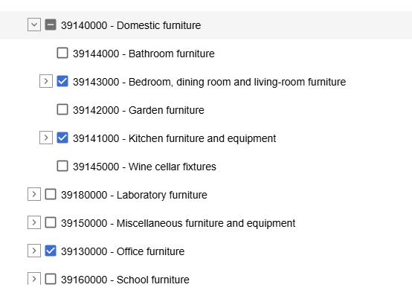
Task 2: Markets
Public procurement: 2024 data
Public Procurement (TED) | EUR 6.28 bn
Sold production (PRODCOM) kitchen furniture, wooden dinning and living room, wooden bedroom, wooden office, metal office | EUR 33.51 bn
% Public Procurement | ~ 18.7%
TED: All notices
Caveats to this approach:
The data quality in TED is poor
The TED data only provides contracts over EUR 140,000
The contract value in TED may contain multiple lots and more types of products
The contract values are provided in national currency
The categories may not correspond fully from one data source to another
https://ted.europa.eu/en/advanced-search

Slide 55
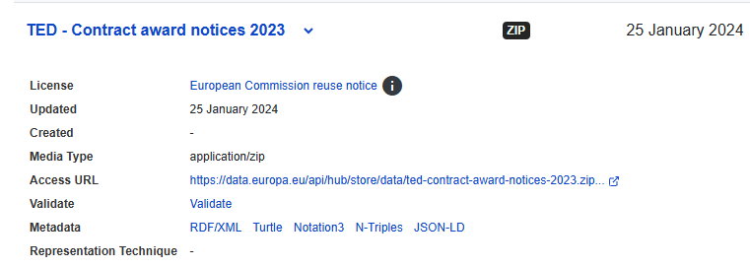
Task 2: Markets
Public procurement: 2023 data
Based on data from award notice
The dataset is (should be corrected for anomalies in contract values)
Source: https://data.europa.eu/data/datasets/ted-csv?locale=en
Public Procurement (TED) | EUR 1.03 bn
Sold production (PRODCOM) | EUR 79.63 bn
% Public Procurement | ~ 1.3%
Public Procurement (TED) | EUR 6.74 bn
Sold production (PRODCOM) kitchen furniture, wooden dinning and living room, wooden bedroom, wooden office, metal office | EUR 36.11 bn
% Public Procurement | ~ 18.66%

Slide 56
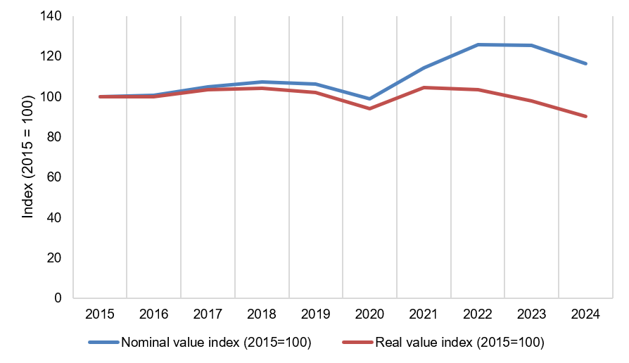
Task 2: Markets
Stock and Market Data
Working average lifetimes
Estimated EU-27 stock, 2024
Product category | Years
Kitchen furniture | 15
Dining/living (wood) | 15
Bedroom furniture (wood) | 13
Other wooden furniture | 15
Wooden office furniture | 12
Upholstered seats (wood frame) | 10
Product category | bn units | Share
Other wooden furniture | 2.29 | 34%
Kitchen furniture | 1.36 | 20%
Dining/living (wood) | 0.99 | 15%
Bedroom furniture (wood) | 0.95 | 14%
Other selected categories | 1.09 | 16%
Total | 6.68 | 100%
Nominal vs real sold production value, 2015–2024
constant 2021 euros
Main findings:
Furniture lifetimes are uncertain but working values generally fall around 10–15 years.
The estimated stock reaches 6.68 billion EU-produced units, dominated by wooden furniture categories.
Nominal sold production value increased 16.4%, but real value declined 9.8%, indicating price-driven growth.
Overall: The EU furniture stock is large and turns over relatively slowly, while recent market value growth has been driven more by prices than by underlying sales growth.
Stock estimate covers EU-produced furniture and is not adjusted for imports/exports, due to data limitations.
Other metal furniture is reported in kg, not pieces, so its stock is shown separately: 18.5 Mt.

Slide 57
Task 2: Markets
Market trends
General market trends
Market channels and production structure
Remote and hybrid work created demand for home-office and space-saving furniture.
Consumers increasingly seek adaptable, comfortable and durable products.
Kitchen furniture the clear “winner” of the Covid pandemic
Manufacturers are shortening supply chains to improve resilience, time-to-market and sustainability.
The European market remains highly competitive and is mainly supplied by local production (80%).
E-commerce, virtual showrooms and configurable online purchasing have become mainstream.
Second-hand sales and specialised resale platforms are expanding.
Trends in product design
Innovation
Durability, modularity, repairability, disassembly and adaptability are gaining prominence.
Stakeholders rate durability as highly important across all furniture categories.
Price remains the top purchase priority; aesthetics, user experience and material/finish quality are also important.
Availability of extended warranty and instructions for repair and care. are important to consumers
3D modelling, AI, digital twins, AR and VR support design, production efficiency and customer visualisation.
Sutainable materials: bio-based (algae), low-carbon wood, recycled plastisc, metals
D2C, digital configuration, take-back, resale and service-oriented models are emerging.
Long product families are perceived as more attractive than Furniture-as-a-Service for domestic users.
Notes:
Direct-to-customer (D2C) is a business model that enables furniture manufacturers to sell their products directly to end customers, bypassing intermediaries such as wholesalers, distributors, or traditional retailers.

Slide 58
Task 2: Markets
Consumer expenditure base data: Consumer prices and price variation
EU-27 production price proxy, 2024
Metal furniture, other, 2024
Indicative retail price spread, selected products, 2026
Product | EUR/unit
Wooden shop furniture | 415
Upholstered seats, wood frame | 270
Kitchen furniture | 178
Dining/living furniture | 144
Bedroom furniture | 83
Other wooden furniture | 61
Measure | EUR/kg
Domestic sales price | 5.00
Change since 2014 | +118%
Product example | Observed range
Kitchen base cabinet | EUR 98–120
Dining table | EUR 67–139
Armchair | EUR 69–115
Shelving/bookcase | EUR 28–55
Bed frame | EUR 159–299
Desk | EUR 80–179
Sources: Eurostat PRODCOM DS-059358
Source: indicative retail prices from selected IKEA and JYSK examples in DE, PL, PT and DK.
Main findings
Consumer prices vary substantially across product types and markets, while Eurostat unit prices should be read as manufacturer selling-price proxies rather than retail prices.
Average production prices increased in most categories between 2014 and 2024.
Retail examples show wide variation by product, retailer and country.

Slide 59
Task 2: Markets
Consumer expenditure base data: Repair, disposal and consumer behaviour
Indicative maintenance and repair costs
Selected disposal-cost examples
Consumer attitudes and barriers
Repair is constrained by cost, convenience and effort, transport, skills, spare parts and product design.
Modularity, standardised components, spare parts and simple instructions support repair.
Activity | Indicative cost / support
Minor DIY surface repair | ~EUR 5
Hardware or accessory repair | Bonus EUR 35; labour ~EUR 85/h
General furniture repair | Bonus EUR 65; minor repairs EUR 20–300
Kitchen worktop repair | EUR 125–450
Upholstered seating repair | Bonus EUR 30–60; repair EUR 200–300
Area / system | Example cost
France EPR | EUR 0.01–112/unit, depending on product
Brussels bulky waste | One free collection up to 3 m³/year; then EUR 28/m³
Dublin bulky waste | EUR 50 for up to five items
Helsinki pick-up | EUR 70–140 for large objects
Stockholm recycling centres | Free drop-off for private individuals
Main findings
Repair and disposal costs vary widely
Disposal costs are highly local and may be covered by municipal fees, bulky waste systems or EPR schemes.
Consumers are more likely to repair when products are valuable, convenient to repair and designed with accessible parts and information.

Slide 60
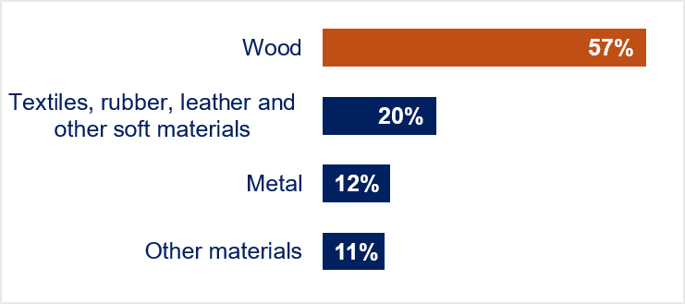
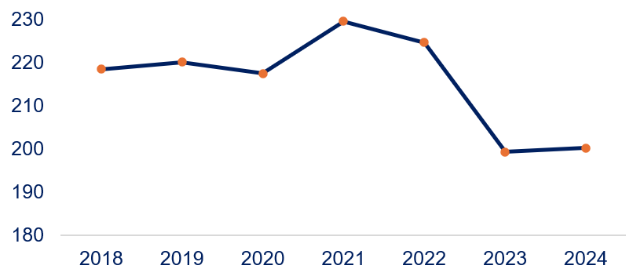
Task 2: Markets
Sourcing of raw materials
Material composition by production value
EU wood supply (sawlogs and veneer logs, mil. m³)
Leading producers:
Germany • Sweden • Finland • Poland • Austria
Source: Circular business training for the furniture and woodworking sectors
(FURN360 Consortium, 2017) Project 2017-1-BE01-KA202-024752
Non-EU import share in EU apparent consumption, 2024
Concentration of external suppliers
Sawnwood | Veneer sheets | Plywood | Particle board/ OSB | Fibreboard
6% | 37% | 44% | 4% | 8%
Sawnwood: Ukraine and Norway;
Fibreboard: Türkiye and Switzerland;
Plywood: China and Brazil;
Veneer sheets: Gabon and Ukraine
Ukraine and China are in top 10 in virtually all categories.
Source: Eurostat

Slide 61
Task 2: Markets
Preliminary conclusions and recommendations
Highly fragmented sector
Very heterogenous product group
Manufacturing dominated by micro-enterprises
Future requirements need to remain proportionate and feasible for micro-enterprises and SMEs
Transition through digitalisation and innovation
Digital tools in design, product visualization, resale market
Innovation in materials (bio-based, recycled) and design
Existing business models (e.g. take-back and refurbishment schemes) can provide data on product features that can support circularity
Prioritise lifetime extension
Durability is the leading circular design priority.
Repair information, spare parts, warranties, reuse and refurbishment merit particular attention in subsequent policy analysis.
Furniture-as-a-Service is emerging in B2B settings
Account for significant data limitations
Waste generation, recycling and end-of-life treatment
Repair, reuse, second-hand market
Base-case construction and policy options should reflect these uncertainties.
Material efficiency and raw material exposure
Wood is the dominant material, facing competition from other sectors
Exposure to non-EU suppliers for veneer sheets and plywood
ESPR measures should consider reduced virgin-material demand and increase of recycled content, especially where import exposure is higher.

Slide 62
Task 2: Markets
Questions to Stakeholders
Q1: Do the 2024 production volumes and values, and the relative importance of the main furniture product categories, appear representative of the EU market?
Q2: Does the decline in reported physical production between 2021 and 2024, including the substantial decline for other wooden furniture, reflect developments observed in the market, or could changes in reporting or product classification partly explain this trend?
Q3: Do the sold production volumes and values presented above broadly reflect the scale and composition of the EU furniture market?
Q4: Does the product coverage used here adequately capture furniture trade relevant to the ESPR, particularly given the importance of furniture parts, components and other product codes outside the eight main categories?
Q5: Do the apparent consumption estimates and import shares presented above broadly reflect the EU furniture market?
Q6: Are additional data available to validate these estimates or enable apparent consumption to be assessed in physical units?
Q7: To what extent do the findings regarding repair, refurbishment, remanufacturing, reuse and second-hand markets reflect current practice in your Member State? Are there additional data sources available?

Slide 63
Task 2: Markets
Questions to Stakeholders
Q8: Do you have knowledge of data, sources of data or estimates regarding the share of PP furniture in the total market size, even at the level of a specific Member State?
Q9: Are additional data available on furniture lifetimes, particularly by product type, material and construction (e.g. solid wood, wood-based panels, metal or plastic), price/market segment or intensity of use?
Q10: Are data available that could improve the stock estimates, particularly by accounting for imported and exported furniture, typical product weights, actual disposal rates or premature end-of-life?
Q11: Which circular business models and circular product characteristics do you consider most relevant for future policy measures addressing furniture products, and why?
Q12: Are you aware of data on the market share of furniture-as-a service and potentially its split between domestic and commercial?
Q13: Are there significant market barriers, supply-chain risks or raw-material challenges that should be given particular attention?

Slide 64
Preparatory Study: MEErP Task 3

Slide 65
Objectives of MEErP Task 3 - Users
Scope expands to user behaviour related to circular economy
Analyse pre-purchase, post-purchase and disposal behaviour
Investigate user purchase drivers, acceptance and willingness to pay for design criteria and circularity aspects
Assess use-phase factors and aspects determining the lifetime of furniture from a user perspective
  → Incl. repair, reuse, maintenance and refurbishment practices, drivers and barriers
Investigate user disposal, and replacement drivers and practices
Collect evidence for the environmental and economic assessments and design options in Tasks 5 and 6

Slide 66
MEErP Task 3 - Users
Role of consumers / users
In furniture, typical use-phase activities like maintenance, care and cleaning account for less than 1% of life-cycle impacts
However, lifetime extension of furniture can indirectly contribute to impact savings
This depends on the actual time a product stays in use, the displacement rate of a new products and other user-dependent factors
Technical product design features
Consumer information
Direct reuse
Product placed
on the market
Use phase I + End-of-use decision
Repair /
refurbishment
Use phase II + End-of-use decision
EoL pathway
USER DECISIONS AND BEHAVIOUR
Yang, D., Vezzoli, C., & Su, H. (2025b). Comprehensive life cycle assessment of 25 furniture pieces across categories for sustainable design. Scientific Reports, 15(1), 13968. https://doi.org/10.1038/s41598-024-84025-8

Slide 67
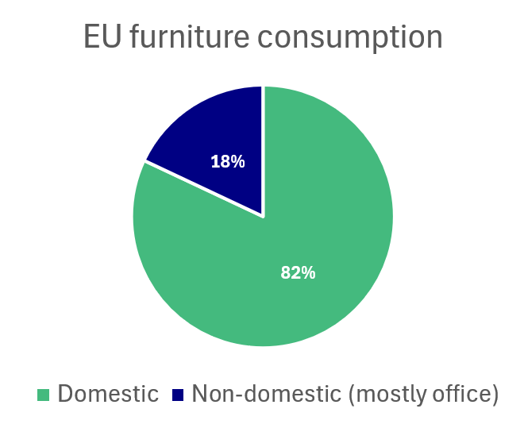
Pre-purchase aspects
(Pre-) purchase
Consumption patterns and purchase drivers
The primary purchase drivers for furniture
FUNCTION
APPEARANCE
QUALITY
PRICE
Sustainability & circularity often play an additional role but are not the primary purchase driver
Furniture purchases are primarily led by immediate user benefits
Technopolis (2024). Research: Ecodesign for furniture.
Technopolis (2024). Research: Ecodesign for furniture. https://www.government.nl/documents/2024/01/31/research-ecodesign-for-furniture
CSIL, CEPS, & Economisti Associati. (2014). THE EU FURNITURE MARKET SITUATION AND A POSSIBLE FURNITURE PRODUCTS INITIATIVE. European Commission DG Enterprise and Industry. https://ec.europa.eu/docsroom/documents/7573/attachments/1/translations/en/renditions/native
Notes:
Furniture purchases are primarily driven by immediate user benefits—functionality, quality, appearance and price. Sustainability and circularity become more influential when translated into tangible benefits such as longer lifetime, easier maintenance, safety or affordability.

Slide 68
Pre-purchase aspects
(Pre-) purchase
Consumer groups take into account different purchase considerations
Private households (82%)
Private B2B
Public GPP
Whole life cost and residual value can matter
Performance in intensive use & reliability
Maintenance and refurbishment
Services
Corporate sustainability targets
…
Compliance with procurement rules / tender criteria
Social and environmental objectives
Best value over the contract period
Durability and service continuity
…
Price
Function / fit
Aesthetics / trends
Convenience
Life events incl. moving
Retail and online consumer information
…

Slide 69
Pre-purchase aspects
(Pre-) purchase
Consumer information
Table 7‑3: Attributes valued in consumer-facing information
Information category | Considered important (%) | Implication
Durability | 81% | Directly relevant to expected service life and one of the strongest information demands.
Dimensions | 80% | Shows the importance of immediately practical, product-specific information.
SoCs | 76% | Health and safety information is highly salient and can provide a concrete entry point for sustainability communication.
Materials used | 68% | Relevant for quality, maintenance, safety and environmental interpretation.
Cleaning instructions | 68% | Links pre-purchase information to maintenance effort and potential lifetime.
Environmental sustainability | 51% | Relevant to a majority, but less important than performance, dimensions and health-related information.
Disposal and recycling instructions | Around 40% | Lower pre-purchase salience than durability, use and maintenance information.
Adapted from CSIL, CEPS, & Economisti Associati. (2014) https://ec.europa.eu/docsroom/documents/7573/attachments/1/translations/en/renditions/native

Slide 70


Use-phase aspects
Use phase
A usable product often reaches its end-of-life before it breaks
Actual service life
Possibility for extension of lifetime
STILL USABLE, NO LONGER FITS NEEDS
Reasons for early displacement before technical failure
Life events / moving / changed needs, e.g. more/less space
Aesthetic reasons / trends / preference for new, etc.
TECHNICAL FAILURE
Breakage/failure of of structure, fittings, upholstery, etc.
Theoretical technical lifetime (potentially longer)
Possibility for extension of lifetime
Actual time a product stays in use matters for environmental impacts
Reliable EU-wide lifetime data is not available and differs by furniture type, material, region, quality-segment, maintenance behaviour, etc.
However, it is frequently reported that furniture is often discarded prior to technical failure.

Slide 71
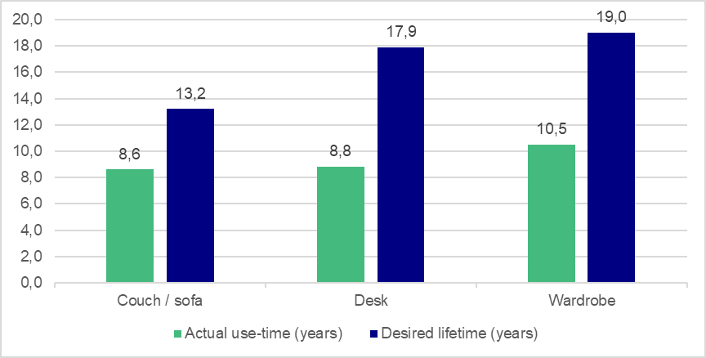
Use-phase aspects
Use phase
Factors that can influence the actual lifetime of furniture:
Furniture type, materials, construction, repairability, etc.
Changes in needs, style/timelessness, perceived durability/quality, emotional attachment, maintenance/care, etc.
Representative Austrian consumer survey example - Reported lifetime vs. desired lifetime
Reliable lifetime data is scarce and region-specific
Other estimates are broad and it is often unclear if data relate to actual use, expected or technical lifetime
Wieser et al., 2015. The Consumers’ Desired and Expected Product Lifetimes ; Cox et al., 2013. https://doi.org/10.1016/j.resconrec.2013.05.003 ; Furmston, 2026. https://dl.designresearchsociety.org/drs-conference-papers/drs2026/researchpapers/16 ; Haugrønning et al., 2021. Consumer practices for extending the social lifetimes of sofas and clothing ; Hebrok, 2016. https://doi.org/10.4000/tc.7855 ; Technopolis, 2024. https://www.government.nl/site/binaries/site-content/collections/documents/2024/01/31/research-ecodesign-for-furniture/Research%2BEcodesign%2Bfor%2Bfurniture.pdf ; ESPR stakeholder survey.

Slide 72
Use-phase extension
Use phase
Maintenance and care behaviour
Practices are material- and product-specific
Evidence supports that appropriate care is important to preserve function and appearance
However, reliable / representative quantitative data on consumer maintenance behaviour/frequency and quantitative effects on lifetime extension potential is not available
Examples
UPHOLSTERY / LEATHER
WOOD SURFACES
FITTINGS
Stain removal
Removable covers
Conditioning
Cleaning
Reoiling / waxing
Tightening
Minor adjustments
CONDITION PRESERVED
+ ? YEARS
ACTUAL LIFETIME
EXTENSION
Yang et al., 2025. https://doi.org/10.1038/s41598-024-84025-8 ; Ackermann, 2018-2021. https://doi.org/10.1080/14606925.2018.1469331 ; https://doi.org/10.4233/uuid:9fe0a3cd-a7f7-4d29-bb44-6dc78575a2e8 ; https://doi.org/10.20900/jsr20210013 ; Yates et al., 1999. https://doi.org/10.1046/j.1365-2737.2000.00091.x ; Gregson et al., 2009. https://doi.org/10.1177/1469540509104376 ; ESPR stakeholder survey.

Slide 73
Use-phase extension
Use phase
Repair of furniture – Actors and time until breakage
Figure 7‑2: Estimated share of repair actors
Source: Dorland & Jørgensen, 2025. https://doi.org/10.1007/s43615-025-00596-2
Figure 7‑3: Reported average years until breakage of all broken furniture items
Source: Dorland & Jørgensen, 2025. https://doi.org/10.1007/s43615-025-00596-2
The available evidence suggests that self-repair dominates in furniture
Time until breakage differs between furniture type
Again, EU-wide data is limited

Slide 74
Use-phase extension
Use phase
Repair of furniture – Repair rates depend on furniture type
Repair drivers
Cheaper price
Product attachment
Sometimes waste prevention and not being able to buy a replacement
Repair barriers
Repair costs too high
Unrepairable design, low-quality materials
Spare parts availability
Consumer preferences for buying new, trends
Specialized tools/skills needed, access to repair information
Logistic/transport burdens
Figure 7‑5: Repair rates by furniture type.
Source: Dorland & Jørgensen, 2025. https://doi.org/10.1007/s43615-025-00596-2

Slide 75
Use-phase extension / intensification
Use phase
Reuse, refurbishment, rental and leasing models
Reuse / Resale / Donations:
Informal and peer-to-peer sale and donations are common
Reuse barriers include:
Incovenience vs. residual value
Bulky, non-dismantable furniture
Damage, hygience concerns, quick clearance needs
Refurbishment:
Most viable for higher-value furniture, especially B2B/GPP
Needs collection, repair/refurbishment and resale capacity
Leasing and renting:
Most established in office/B2B, where return routes are formalised
Ownership preferences limit B2C uptake

Slide 76
Use-phase extension
Use phase
Displacement, secondary lifetime and rebound determine real impact savings
Source | Results | Limitations
Hrafnkelsdóttir, 2022. https://urn.kb.se/resolve?urn=urn:nbn:se:kth:diva-315376 | Climate impact reduction via furniture reuse: 42-80% climate-impact reduction | Model result sensitive to displacement rate, transport and item mix
Snijder et al., 2019. https://marktplaatsperskamer.nl/wp-content/uploads/2019/10/191009-CE-Delft-Impact-study-enviromental-benefit-Marktplaats-trading.pdf | Estimated secondary-life extension factor = 1.5x +4.6 years furniture average +5.3 couches +6.1 tables +4.4 beds | Represents potential extension rather than direct observation
Bubinek et al., 2025. https://doi.org/10.1016/j.spc.2024.12.019 | 100% displacement + no rebound scenario: 69 t furniture reuse saves 126 t CO2e (1.8 kg CO2e/kg reused) | Benefits strongly reduced and even reversed by more realistic rebound (80-167%) & displacement rate (30%) considerations
Delanoeije & Bachus, 2022). https://doi.org/10.1016/j.resconrec.2022.106414 | Estimated displacement rate: reused furniture replacing a new acquisition in only around 29% of cases
Actual impact savings of reuse depend on:
Displacement rate (rate of replacing new furniture)
Rebound effects (free income used for other consumption)
Secondary lifetime (additional years in use)

Slide 77
End-of-life aspects
EoL
Collection
Collection and handling can preserve or undermine furniture reuse potential and value
  Reuse networks, charities and social enterprises
  Retailer / manufacturer take-back
  Material-specific waste handling (e.g., wood waste)
  Municipal bulky waste handling → Reuse potential depends on handling
  Informal street dumping
No reliable EU-data on end-of-life routing of furniture available
Example - Bavarian recycling centre site study
Only 24% of discarded items were damaged
36% of recorded damage was linked to collection stage
Bayerisches Staatsministerium (2019). https://www.bestellen.bayern.de/stmuv-abfall-006

Slide 78
End-of-life aspects
EoL
Furniture waste and EoL routing data remain fragmented
Disposal behaviour and country-/region-specific waste-management infrastructure determines EoL routing
No dedicated waste codes for furniture exist → may be recorded as bulky waste, wood waste, metal waste, residual waste of WEEE
National collection, EPR and treatment infrastructures differ substantially
Informal routes are not captured → Informal resale/donation avoids waste status but is poorly captured in official statistics
Available estimates (10.8 Mt) are indirect estimates based on assumed share of furniture in municipal waste plus a factor for business furniture
Reliable EU-level or even country-level data on waste amounts and EoL routing is not available

Slide 79
Questions to stakeholders
Overall substantial data gaps: Reliable furniture lifetime and consumer behaviour related data and EoL data is scarce & uncertain
→ Uncertainty in predicting impact reduction potential and effect of ESPR interventions
Q1 - What approximate share of sales is B2C, B2B/contract and public procurement, and does this materially affect product specifications, consumption preferences and expected lifetime?
Q2 - Do you have quantitative consumer data on the frequency of purchase of different furniture types? Do you have data on displacement rates, rebound effects and secondary lifetime data?
Q3 - Which ESPR-relevant product information is most likely to influence actual furniture purchase decisions, willingness to pay and lifetime extension?
Q4 - How should information on durability and other circularity characteristics be presented so that consumers can meaningfully compare furniture products?
Q5 - Do you have, or can you provide first-hand consumer data on the actual use-time of different furniture types? Where possible, please provide the product type you refer to, average/median lifetimes, distributions or ranges, sample size, geography and information on the reason why use ended.
Q6 - Approximately what share is replaced because of technical/structural failure versus non-technical reasons

Slide 80
Questions to stakeholders
Q7 – Can you provide quantitative data on the most common and relevant maintenance aspects for different types of furniture, including lifetime extension potential (months/years) and consumer maintenance behaviour data?
Q8 - Which share of furniture is typically self-repaired, which share goes into formal repair streams? How does this differentiate between different furniture types?
Q9 - Would design changes such as removable upholstery, replaceable fittings, non-destructive fasteners or accessible mechanisms significantly reduce repair time/cost? If possible, quantify the difference.
Q10 - What are the most common failures and how high are the costs to replace/repair these damages relative to buying new? Which components genuinely require spare-part availability? Which components would need to become more accessible or replaceable?
Q11 - Which furniture categories already have a commercially viable refurbishment market, and which are unlikely to become viable? Why?
Q12 - Do you have quantitative data on the share of furniture that enters a second use cycle, differentiated by furniture type and reuse channels?
Q13 - At which stage of current collection and sorting systems are furniture items with reuse or refurbishment potential identified? What share of this potential is currently captured before products enter destructive treatment?
Q14 - Do you have quantitative data on EU- or country-level furniture waste and EoL routing data?

Slide 81
Lunch Break– 75 min
Please note that there is unfortunately no canteen / cafeteria in CCAB anymore.
For lunch, you will need to go out and have a short lunch in the many places around CCAB.
Online participants are kindly requested to return at 13h25

Slide 82
Agenda
Time | Topic | Duration | Presenter
09.30-09.35 | Welcome | 5 min | DG ENV
09.35-09.40 | Introduction | 5 min | VITO
09.40-09.45 | Introduction to the study team | 5 min | Trinomics
09.45-09.55 | Introduction to the study | 10 min | Trinomics & Oeko-Institute
09.55-10.35 | Task 1- Scope | 40 min | Oeko-Institute
10.35-10.50 | Coffee-Break | 15 min
10.50-11.30 | Task 2- Market | 40 min | Trinomics
11.30-12.10 | Task 3- Users | 40 min | Oeko-Institute
12.10-13.25 | Lunch Break | 75 min
13.25-13.40 | LCA Findings | 15 min | Ecoinnovazione
13.40-14.20 | Task 4 -Technologies | 40 min | Oeko-Institute
14.20-14.35 | Coffee-Break | 15 min
14.35-15.20 | Base Cases | 45 min | Ecoinnovazione & Oeko-Institute
15.20-15.50 | DPP Aspect | 30 min | Fraunhofer IZM
15.50-16:00 | Closing words and next steps | 10 mins | Trinomics & Oeko-Institute

Slide 83
Preparatory Study: LCA Findings

Slide 84
LCA Task: goal and coverage of the analysis
Goal of the task:
  Identify the main environmental hotspots of furniture products, components and processes (“what matters” and “where” in the value chain)
  Evaluate the availability of data for informing the base cases and their assessment
  Identify main knowledge gaps and data collection needs
Body of documentation analysed:
  Scientific publications on LCAs and environmental assessment of furniture (2014-2026), public technical sources, projects funded under HE or previous funding programmes
  EPDs published with different programme operators (global scale) (> 350), valid, publicly accessible
Coverage of the information
  Indoor furniture mainly, including seatings, desks and tables, storage furniture and wood-based panels
  Less covered: beds, outdoor, kitchens, children’s and multifunctional furniture
  Good level of details of materials used in the different applications, current trends in material types to be confirmed (e.g., rattan, cork, bamboo, …)

Slide 85
Task LCA: main findings
The analysis of the environmental hotspots confirmed the findings that informed the current Ecolabel criteria:
  Relevance of the production and supply of materials (> 80% of environmental impacts), with differences according to the product categories
  Manufacturing contributes on average 10%, with relevant contributions coming from finishing processes, resins and energy
  End of life depends on the type of product (material composition, structure and treatment route) but it is not negligible
This information is used to size the relevance of the impacts for this product category, and for understanding where more improvements opportunities exist. However, these are not related to single interventions but to their combined effects:
  Improved end of life performances are driven by design choices beyond materials, and by performance characteristics that affect e.g., modularity, durability
  Service life and durability: the analysed studies consider a default durability (set by product category rules) of 10-15 years; limited information on measures to extend the durability
  Durability is informed by cyclic loading and other stress tests performed according to relevant furniture standards → need to define criteria for the different product groups

Slide 86
LCA Task: main findings
Bill of Materials defined for the main functional groups of furniture, building upon the ongoing work in CEN/TC 207, and for subgroups in these categories
  4 functional groups + 1:
Seating furniture
e.g., chairs, sofas
Storage furniture
e.g., cabinets, wardrobes, bookshelves
Tables and work surfaces
e.g., dining tables, desks
Bed frames
e.g., excluding mattresses
Diverse
other products not specifically identified
Non-upholstered chairs
Wood-based small/drawers
Wood-based desk
Wood-based bed frame
No specific functional classes
Upholstered sofas
Metal-based small/drawers
Metal-based desk
Upholstered multipurpose office chairs
Wood-based low closed
Mixed material desk
Kitchen: currently not a separate category.
A number of common kitchen elements, such as cabinets, drawer units, shelving and table-like components, are comparable from the functional perspective to those already covered within the storage and table categories.
Upholstered task chairs
Metal-based low closed
Wood-based dining table
Upholstered visitor and lounge chairs
Wood-based tall closed
Metal-based dining table
Metal-based tall closed
Wood-based coffee table
Wood-based open
Wood-based meeting table

Slide 87
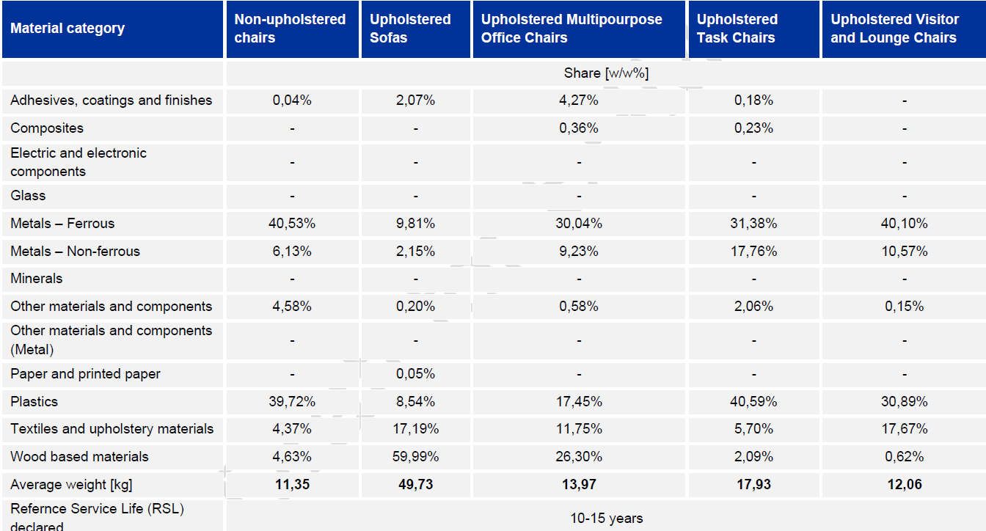
LCA findings: seating furnitures

Slide 88
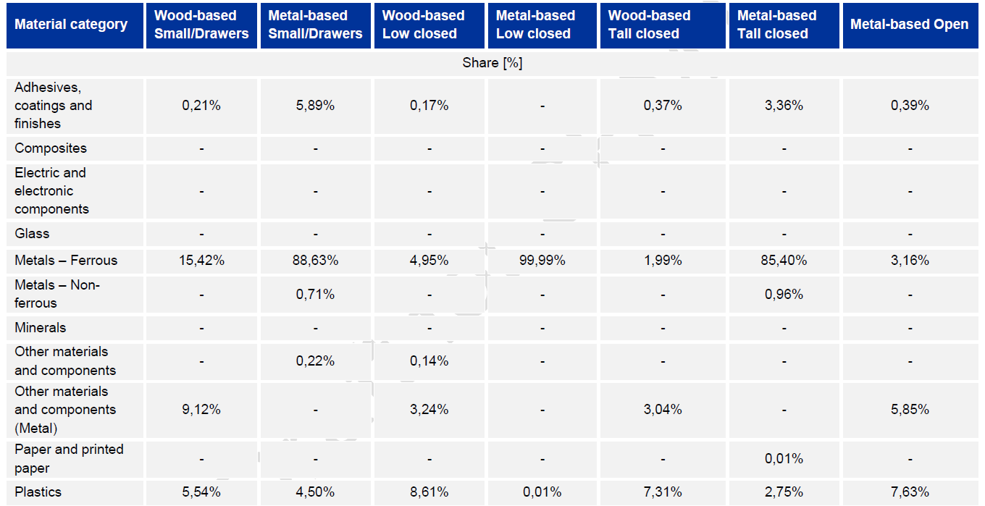
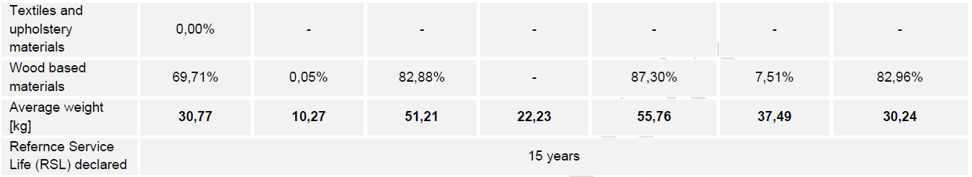
LCA findings: storage furnitures

Slide 89
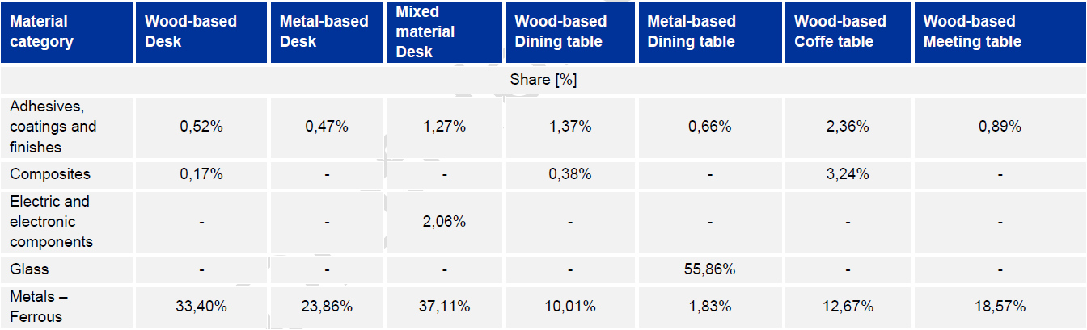
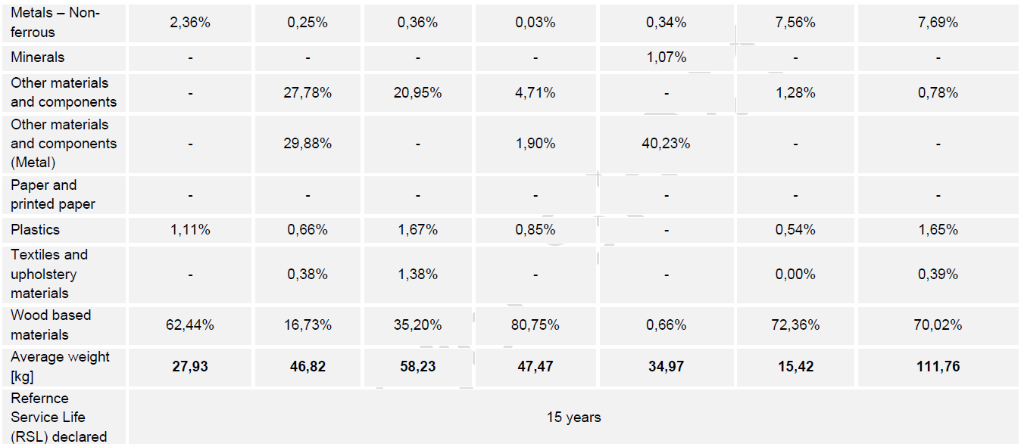
LCA findings: tables furnitures

Slide 90
Use of LCA data in the next Tasks
Base-case LCI
materials + production + use + EoL
Task 5 – Identify environmental hotspots
Determine which materials, processes and life-cycle stages drive environmental impacts.
Assess the influence of key assumptions such as product lifetime, manufacturing energy, transport and end-of-life.
Establish the environmental baseline for each representative Base Case
PEF model
EF datasets
Task 6 – Assess design options
Use the hotspots to define potential improvement measures (e.g., durability, repairability, reuse or end-of-life performance).
Recalculate environmental performance for the Design Options and compare it with the Base Case.
Combine environmental results with Life Cycle Costing to assess improvement potential, costs and technical/economic feasibility
Hotspot & sensitivity
drivers, assumptions, scenarios
Task 6 inputs
design options
Task 7 – Support policy assessment
Translate the improvement potential of the Design Options into EU-level scenarios.
Compare Business-as-Usual with possible policy interventions and estimate their environmental, economic and social impacts.
Use the results to support the identification of ESPR requirements.
Task 7 inputs
Policy assessment

Slide 91
LCA of the Base Cases: PEF study
1
2
3
4
Confirm Base Cases (see next slides)
Complete inventories with production data
Develop the PEF model
Calculate the environmental profile of the Base Cases
market weights + product configuration
process routes, energy, scraps, chemicals, EoL
PEF method, and EF data
hotspots, sensitivities, missing data
Data to collect or validate for the Base Cases
No furniture-specific PEFCR are available. The PEF method will provide the reference for quantifying the environmental profile of the Base Cases
Mass and BoM
Electricity, thermal energy, waste treatments, water consumption
Adhesives, resins, coatings, solvents and emissions
Packaging, transport distances and load factors
Lifetime
End of life treatments

Slide 92
Questions to stakeholders
Q1. Specific characteristics of other furniture categories. For outdoor furniture, bathroom furniture, children’s furniture and multifunctional furniture (e.g. furniture combining seating and storage functions), are there any specific characteristics or design features that would require particular consideration compared with the product groups already identified?
Q2. Bed frames. Which bed frame types should be considered representative of the EU market in terms of product mass, material composition and structural design?
Q3. Definition of durability and appropriate level of granularity. At what level of granularity should durability be defined for furniture? Could representative values be established by application/use context (e.g. domestic, office, contract/public, outdoor), using average or typical values? Are the values used in EPDs of 10-15 years suitable?
Q4. Coatings, surface treatments and resins. Can representative coating, surface treatment and resin recipes be defined according to the application/use context of the furniture (e.g. indoor, outdoor, bathroom)? If so, what data could be used to define typical material types and application quantities?

Slide 93
Preparatory Study: MEErP Task 4

Slide 94
Objectives of MEErP Task 4
Describe and determine the technologies and processes and relevant parameters to support LCA task 5 and Task 6
Materials and components
Production and distribution
Bill of substances
End of life
BAT, BNAT and ESPR aspects
Wood, upholstery, metals, plastics, coatings, joining
Assembly models, flat-pack versus assembled, packaging
Substances of concern, categories A–D, legacy chemicals
Collection, treatment routes, waste wood, recycling technologies
Clusters, performance tiers, trade-offs

Slide 95
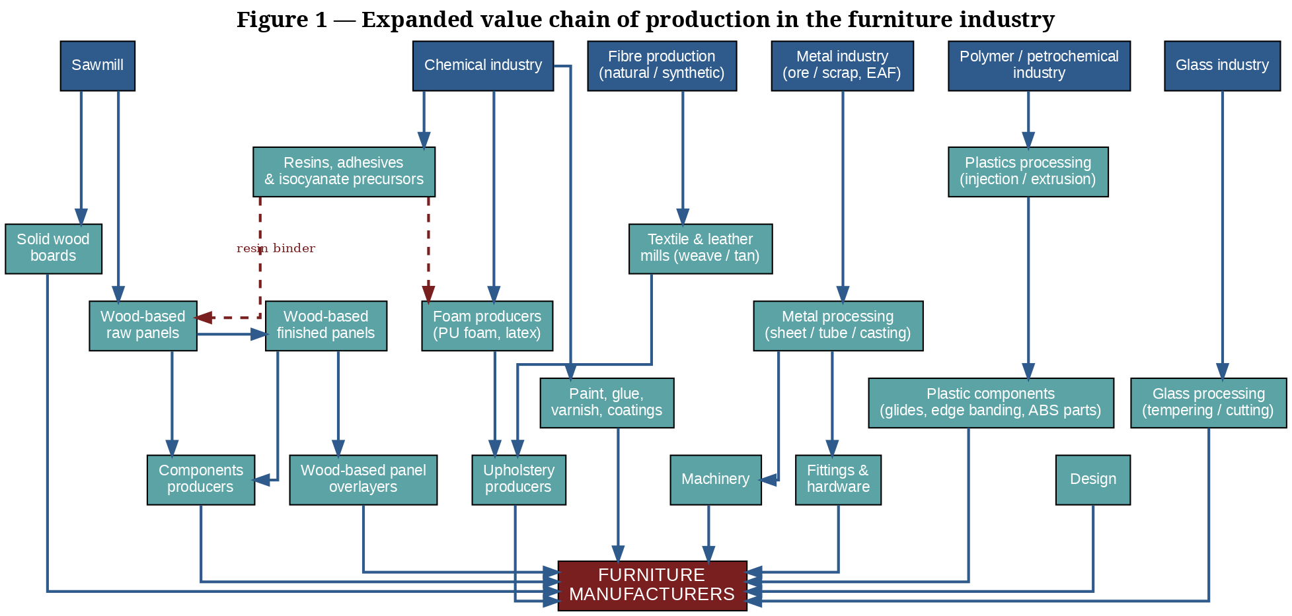
Furniture is an assembly of independent material value chains.

Slide 96
Product Bill of Materials
Summary of Archetypes from EPD Analysis
EPD data is not sales-weighted, mostly contract furniture
No bed frames or kitchens
Outdoor furniture missing
-> Approached first by material characteristics
Group | Reference products | Mass | Dominant materials
Seating | Non-upholstered chairs; sofas; multipurpose, task and visitor/lounge chairs (5) | 11–50 kg | Office chairs 56–90% metal and plastic; sofas ~60% wood
Storage | Wood- and metal-based small, low and tall closed units; metal open unit (7) | 10–56 kg | Wood-based 70–87% wood; metal closed 85–100% steel
Tables | Wood, metal and mixed desks; dining, coffee and meeting tables (7) | 15–112 kg | Wood-based 62–81% wood; metal dining table 56% glass

Slide 97
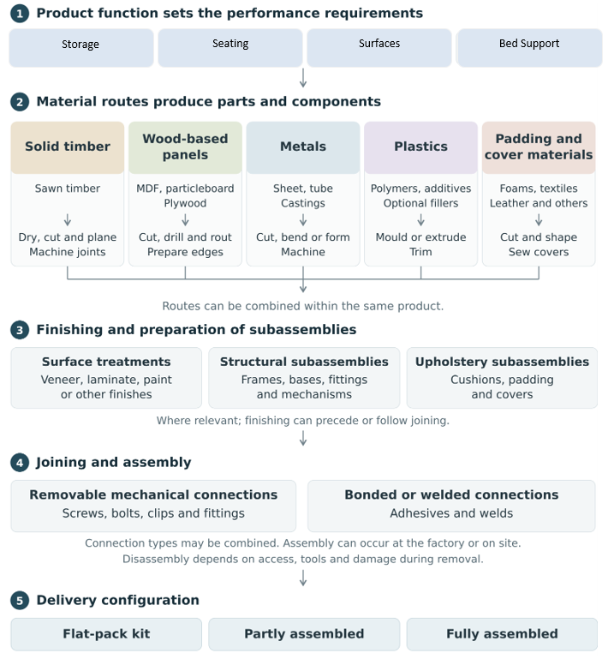
Furniture Production
Overview
Most material-level impacts (resin chemistry, alloy, foam formulation) sit with upstream suppliers, who are already covered by BREFs (Best Available Techniques Reference Document).
There is no BREF for furniture itself.
Manufacturers can influence product design:
  material selection,
  joining method
  business model (flat-pack vs. assembled vs. installed).
  Implication: requirements on resin chemistry, alloys or foam formulation act through supplier specifications, not on the assembly line.

Slide 98
Sourcing considerations
Example of Wood Panels
Wood Panel Type | Countries | Production 2024 (million m³) | % of wood panel market | % used in furniture
Particleboard | EU27 + UK + EFTA | 31.3 | 53 % | 68 %
Medium Density Fibreboard (MDF) | EU27 + UK + EFTA | 11.3 | 19 % | 53 %
Oriented Strand Board (OSB) | EU27 + UK + EFTA | 7.1 | 12 % | 4 %
Softboard | EU27 + EFTA | 5.3 | 9 % | -
Plywood | EU27 | 2.7 | 5 % | 26 %
Hardboard | EU27 + EFTA | 0.4 | 1 % | 19 %
Total wood-based panels |  | 58.1 | 100 % | 49 %
The same wooden storage product could have very different sourcing properties depending on where the panel comes from.

Slide 99
End of Life is strongly dependent on local infrastructure, regulations
EoL Data are generally hard to determine due to lack of furniture waste code.
Can consider (simplified) under four scenarios:
System | Example | Furniture outcome
EPR, separate collection | France | 2023: 5% reuse, 45% recycling, 47% energy recovery
Energy recovery | Germany (AltholzV) | ~74% of waste wood to energy recovery
Panel recycling | Italy | Over 90% recovered wood in particleboard
Landfill | Several S/E states | Up to ~80% of municipal waste landfilled
Implication: recyclability or recycled-content requirement cannot assume one end-of-life route; its real effect will vary by Member State.

Slide 100
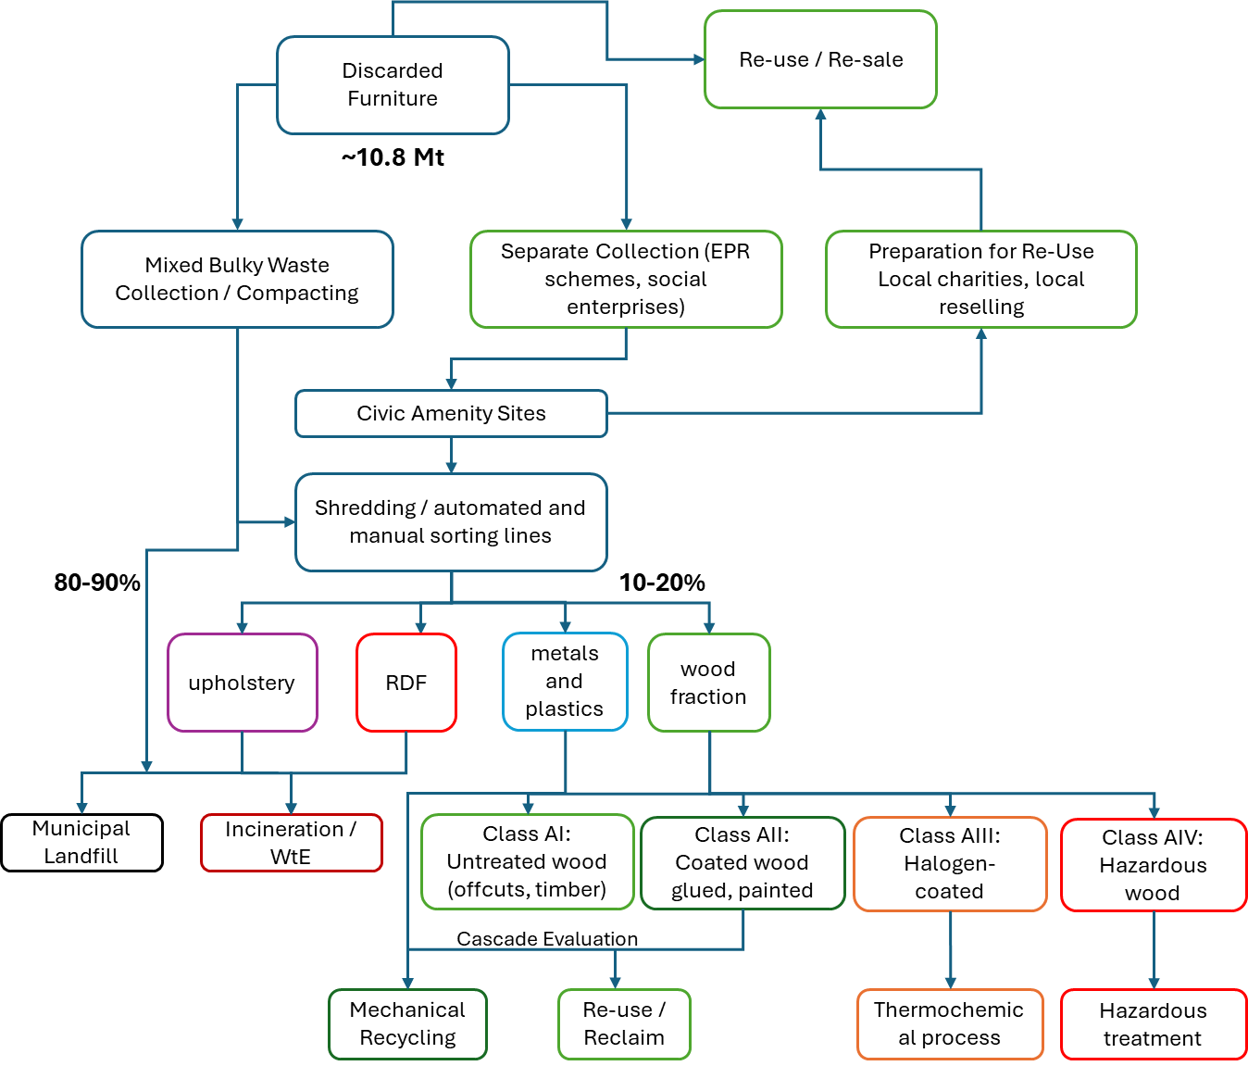
Furniture EoL Flows
If estimate 3.75% of bulky waste is furniture, then reach a top-down estimate is about 10.5 Mt/yr in 2023, within a plausible range of 7–14 Mt.
French put on market scaled to EU27 -> 20Mt per year including mattresses.
Collected furniture waste in only mature EPR scheme (France) was 1,292,185 t in 2023 (Ecomaisoon: 41.2% of POM). 17.9 kg per person.
Question 4-1: are there data available that can help improve percentage flows here?

Slide 101
Reported Recycled Content
From Stakeholder Survey
Recycled content potential depends strongly on material stream.
Affects material properties and e.g. durability of product.
Stream | Reported achievable share | Limitations
Wood panels | 20% to ~100% (highest in Italy) | Sorting quality, contamination, bioenergy competition
Metals | 80–100% via electric arc steel | Scrap demand already exceeds supply -> higher costs
Plastics | 20–60%; ~100% mass balance possible | Closed loop obligations for packaging reduce feedstock; uneven quality
PU foam | Bonded foam has different properties: low in comfort layers; higher shares possible in support layers | Rebonded foam cannot match comfort and density
Textiles | rPET mature; textile-to-textile minimal | PET kept in packaging loops; 80–99% purity needed
Leather | Up to 100%, open-loop | Weak demand vs new leather

Slide 102
Best Available Technologies (BAT)
Near available (BNAT) | Status in report
Debondable, bio-based binders | Finishes near industrial; cores low TRL
NIR and AI sorting of waste wood | TRL 6
mTMP and dry impact MDF recycling | TRL 5–6; up to 25% recycled fibre
Steam explosion to remove UF glue | Laboratory process
PU split-phase recycling and HTC | Split phase emerging; HTC lab scale
Best available (BAT)
Processes set by upstream BREFs: wood-based panels, solvent and metal surface treatment, textiles, tanning
Draft STM BREF proposes Cr(VI) plating as negative BAT
Product level: reversible mechanical joining, mono-materials, standardised parts
Question 4-2
This list is not exhaustive - are there important BATs or BNATs from technology side that we should take up in the study that would be feasible by 2030?
((Task 6 will ask more specific questions)

Slide 103
Substances of Concern
Bill of Substances
Screens Applied:
This does not cover measured presence or concentration
Detailed assessment will follow as part of Task 5
EU Ecolabel criteria
REACH Annex XVII
POPs Regulation
Decision (EU) 2016/1332 names ~80 substances, plus a general SVHC and CLP ban with derogations. Covers A–C, not D.
Restriction entries mapped onto the materials declared in 224 EPDs.
Annex I POPs mapped onto the same EPD material list.
A · SVHCs (REACH Art. 57/59)
B · CLP classes: CMR, ED, PBT…
C · POPs (Reg. 2019/1021)
D · Hinders reuse or recycling

Slide 104
Nine main recurring substance groups
Bill of substances
Group | Where it occurs in furniture | Regulation
Formaldehyde, resins | MDF, particleboard, plywood, laminates, glues | REACH e77: 0.062 mg/m³ (Aug 2026)
Brominated FRs | Upholstery foam/textiles, housings, cables | POPs: PBDEs, HBCDD, Dechlorane Plus
Phthalates | Soft PVC, coated fabrics, edge bands | REACH e51: ≥0.1% in plasticised parts
SCCPs | PVC, rubber, coatings, leather grease | POPs
PFAS | Stain- and water-repellent finishes | POPs: PFOS, PFOA, PFHxS
Heavy metals | Plating, tanning, fittings, pigments | REACH e27 Ni, e63 Pb; Cr(VI), Cd
PCP | Legacy treated or recovered wood | POPs
VOC/SVOC chemicals | Lacquers, stains, adhesives, foams | Ecolabel VOC limits; EN 16516
UV-328 | UV stabiliser in outdoor plastics, coatings | POPs

Slide 105
Circularity blockers and legacy chemicals
Draft Category D List
UF resins: weaker bond, more swelling in recycled panels
Melamine as foam flame retardant: contaminates foam recovery
PFAS finishes: carried into textile recycling
DEHP in PVC edge banding: leaches into mixed plastics
UV-328 in legacy outdoor plastics: limits recycling
Chromium in tanned leather: blocks biological recycling
UV-cured acrylic topcoats: micro-shards in recycled MDF
Legacy Substances in recyclate
PCP in historic treated wood
Cr(VI) in older leather
PBDEs and HBCDD in older upholstery and housings
Phthalates and SCCPs in older PVC
Question to stakeholders: which of these hinder recycling in practice?
Are there other substances to take into account?

Slide 106
ESPR Aspects
Clusters taken forward from Task 1 to assess technical viability
Cluster | Environmental potential | Technical feasibility | Market dynamics | Standards basis
Durability and reliability | High: avoids early replacement | Test methods exist | Use often shorter than technical life | EN 1728, 1730, 16122, 12520, 16139
Maintenance and repairability | Extends lifepan | Needs design shift | Self-repair dominant; labour costly | CEN WG10 method in development
Disassembly and modularity | Enables the other clusters | Practised in flat-pack, office, but re-assembly is not the same as disassembly | Joint choice drives cost | EN 17902:2023 (criteria only)
Recyclability and recycled content | Less landfill, less virgin input | Material- and MS-dependent | Scrap and wood competition | EN 45555 (generic); ISO 22095
Resource efficiency, bio-based | Lower embodied impact | Lightweighting in use | Led by large producers | LCA/EPD; no furniture PEFCR

Slide 107
ESPR Aspects
Cluster | Task 1-4 finding | Consideration | Questions
Durability, reliability | EN tests mature; upholstery excluded | Target reasons for premature disposal: moves, covers, surfaces | Which part is most important for causing product failure?
Repair, maintenance | 78% of repairs are self-repairs | Common tools, target main wear parts only | Priority repair parts per base case?
Upgradeability, modularity, DfD | EN 17902: criteria, no thresholds | Disassembly cycles per material substrate | Cycles survived by panel type?
Recyclability, recycled content | Feasibility set by stream and Member State infrastructure/policy | Thresholds per material stream | Accounting method mostly chain of custody mass balance; wood cascades?
Resource efficiency, bio-based | No furniture PEFCR; EPDs not comparable | Mass cap could cut durability | Data linking mass to service life?

Slide 108
ESPR Aspects
The problematic EoL fractions are composites.
  Metals and mono-material plastics recycle well.
  Foam and textile/leather layers are bonded and lack recyclate markets.
  Wood has a cascading route (solid wood to particleboard), but there is no harmonised EU framework for it.
Best Available Technology: stakeholders converge on reversible mechanical fastening, mono-materials and standardised interchangeable parts. This supports disassembly, repair, modularity and recyclability at the same time.
Durability provides design constraints: Reversibility only helps if the substrate survives repeated cycles. Thin particleboard does not, while solid wood and metal frames do. Lightweighting and durability are the most consistently conflicting pair in the trade-off matrix.

Slide 109
Durability and Reliability
Set by joint and panel design plus material; solid wood and metal frames last longest.
Joint hazard rates vary widely: dowels ~8×, eccentric connectors up to 57× confirmat screws.
Different parts have different lifetimes: covers and cushions wear and soil before the frame fails.
EN strength tests are mature, but upholstery durability is outside their scope.
No mapping yet of which component ends each product's life.
Performance ladder
Base e.g. EN standards EN 12520 / 16139 compliance; technical life ~7–15 years
BAT · Joinery set jointly with repeat-disassembly targets
Reference points in Ecolabels
Tiers to be quantified in Task 6
Consideration for requirements
Question to stakeholders
Sofas are used 8.6 years against 13.2 desired, mostly ending for non-technical reasons. Could target robustness for moves, reassembly, cover and surface wear.
Which component or joint usually ends each product's life? Which of these failures do EN tests not cover?

Slide 110
Disassembly & reassembly
Joints run from reversible (cam-locks, bolts, dry dowels) to permanent (staples, glue, welds).
EN 17902:2023 gives criteria only: no thresholds or cycle counts.
Moves and room changes are leading disposal triggers: reassembly without damage keeps products in use.
Particleboard fixings strip on reuse; thin panels and many joints reduce stiffness.
Permanent joints mainly harm recycling across material boundaries (stakeholder view).
Performance ladder
Base · Mixed reversible and bonded joints; steps undocumented
BAT · Basic tools, unskilled labour, standardised fixings, e.g. EN 17902 with cycles per functional type
Reference points in Ecolabels
to be better quantified in Task 6
Consideration for requirements
Question to stakeholders
Name the substrate and the cycles it must survive. Separability may only need to apply at material interfaces.
How many cycles do common joints survive by panel/material type and thickness? Which modular systems survive repeated moves?

Slide 111
ESPR aspects synergies and tensions
Synergies
Tensions
Disassembly and repair: same fasteners, same access
Disassembly and recyclability: reversible joints give clean recycling streams
Repair and resource efficiency: longer life spreads embodied impact
Durability and lightweighting: less material, shorter life
Durability and modularity: many joints on weak panels
Recycled content and durability: material performance
Recycled wood and bioenergy: one feedstock, two buyers (political)
Mixed: durability and recyclability. Durable mono-material products help; durable bonded composites end up incinerated.

Slide 112
Questions overview Task 4
Question 4-1: are there data available that can help improve percentage EoL flows?
Question 4-2: are there important BATs or BNATs from technology side that we should take up in the study that would be feasible by e.g. 2030?
Question 4-3: is there evidence that SoCs hinder recycling in practice? Are there other substances to take into account?
Question 4-4: are there commonly failing parts that could be considered for targeted durability requirements
Question 4-5: can priority repair parts be defined?
Question 4-6: are there data to support design for disassembly cycles by material type in addition to joining types?
Do voluntary labels form a good basis for technical requirement proposals? E.g. FEMB, Ecolabel?

Slide 113
Coffee Break – 15 min
Please be back at 14:35

Slide 114
Preparatory Study: Base Cases

Slide 115
Base Cases
Base Cases define the baseline against which each improvement (design) option is tested. They make comparison possible across environmental performance, life-cycle costs, technical feasibility
The base cases are defined around the concept of “representative products”, i.e., a real or virtual (non-existing) product, based on average European market sales-weighted characteristics for all existing technologies/materials covered by the product category or sub-category.
Criteria considered for informing the definition of base cases:
Market mix and applications
Technology Archetypes
Performanc
Filtering process for representative products
Storage furniture
e.g., cabinets, wardrobes, bookshelves
Seating furniture
e.g., chairs, sofas
Bed frames
e.g., excluding mattresses
Tables and work surfaces
e.g., dining tables, desks
Diverse
other products not specifically identified

Slide 116
The Representative Product Challenge
Market data is not clean
1000s of products and material types
Eurostat Production data is not available by functional category, only reported in kg for metal furniture
Reporting is in broad groups of dining room, kitchen, or bedroom furniture
Comext follows similar categories and gives import/export in kg
Waste data only exist for bulky waste, only France has EPR data.
EPDs are not representative of the market, mostly commercial furniture
This is why no data readily available on furniture and almost all literature cites 2014 CSIL EU furniture market study and Eunomia/EEB 2017 study values for EU totals.
We attempt a new methodology to reach weighting by material and archetypes

Slide 117
Approach to Base Cases definition
Our approach:
Definition of the main classes, based on function, applications and distinctive characteristics.
Built up of the EU apparent consumption in physical mass (EU production + import-export). Data averaged over 2021-2024
Matching of prodcom and comext statistical product codes with the classifications to obtain the market weight of each archetype.
Description of each archetype using the BoM from LCAs, EPDs and the other sources analysed in LCA Task
The combination of the market weights with the BoMs results in the proposed Base Cases

Slide 118
Methodology Overview (Preliminary Approach)
Market Weights
Prodcom
EU sold production, EUR (and units)
Apparent consumption
EU production + imports − exports, kg per CN code, 2021–24
32 codes ·
Gives us central estimate of 17.9 Mt/yr, but large range:
(13.7–22.2 Mt)
Archetype weights
Mixed codes split by function (storage, table, bed, outdoor) and segment
44 archetypes · mass share within each category
Base case per category
Σ weight × BOM
7 categories
3 segments (domestic, commercial, outdoor)
EU material totals in kt/yr
× €/kg
Comext
Extra-EU imports and exports, kg, by CN code
Compositions
Example-product bills of materials
• Product EPDs (EN 15804)
• Study EPD base data: 186 EPDs, cleaned, pooled in 11 groups
• Yang et al. 2025 (25 pieces) · Aggarwal et al. 2026 · JRC averages
• Engineering estimates where nothing else exists (18 archetypes)
Limitations: strong focus on commercial,
Archetype BOMs
Mass % in 11 material classes, packaging removed

Slide 119
Trade codes room and materials assumptions
Assumed split of each mixed code (share of mass). Darker = larger share.
Furniture codes (CN) | kt/yr | Storage | Table | Bed | Outdoor | Other*
9403.50 Wooden bedroom | 2,266 | 65% | – | 30% | – | 5%
9403.60.10 Wooden dining / living | 2,525 | 55% | 35% | – | – | 10%
9403.60.90 Other wooden | 2,221 | 50% | 15% | – | 15% | 20%
9403.20.80 Other metal | 1,818 | 30% | 15% | – | 40% | 15%
9403.70 Plastics | 167 | 35% | 10% | – | 45% | 10%
9403.82/.83 Bamboo, rattan | 18 | 30% | 30% | – | 30% | 10%
9403.89 Other materials | 106 | 30% | 30% | – | 30% | 10%
9403.10.58 / 30.19 Office ≤ 80 cm | 454 | 50% | 50% | – | – | –
Seating codes (CN) | kt/yr | Dom. | Com. | Outd.
9401.61 Uph., wood frame | 1,193 | 90% | 10% | –
9401.71 Uph., metal frame | 529 | 60% | 40% | –
9401.41/.49 Sofa-beds | 424 | 100% | – | –
9401.69 Wood frame | 161 | 65% | 20% | 15%
9401.79 Metal frame | 471 | 30% | 30% | 40%
9401.80 Other (plastic) | 119 | 30% | 10% | 60%
9401.52/.59 Bamboo, cane | 6 | 50% | – | 50%
* Other = out of scope (mirrors, hallstands, bathroom, shop furniture).
Further splits inside categories
Domestic wooden storage 80% panel
dining tables 60% panel
30% of tables occasional
wooden beds 70% panel
mattress supports 50% box-spring
Direct from data, no split
Kitchen units · office storage and desks · metal beds · office chairs (budget segment = extra-EU imports)
Not included in current assessent: Shop Furniture
Biggest Impacts of assumptions
Other metal 40% outdoor (≈0.7 Mt to garden tables)
bedroom 30% beds (≈340 kt between storage and beds)
Question: These are assumptions, can stakeholders confirm are the percentages are plausible?

Slide 120
What the average kilogram is made of
Base case per category, % by mass, all segments, packaging excluded. EU27 apparent consumption 2021–24.
EU27 kt/yr
Total 17,937 (13,651–22,223)
4,266 Kitchens
5,423 Storage
3,704 Tables
2,146 Upholstered seating
1,242 Beds
756 Non-upholstered seating
400 Office chairs
Question: Does this material split seem plausible? If not, can you provide data to improve it (beds and kitchen EPDs missing)
Notes:
Kitchens 97% panels; storage 65% panels, 22% steel; office chairs 38% steel, 33% plastics. Beds rest entirely on engineering estimates (Low confidence).

Slide 121
All furniture: what the EU puts on the market
Material composition of all seven categories combined, % by mass, EU27 apparent consumption average 2021–24.
Material | kt/yr | Share | Low–high
Wood-based panels | 9,326 | 52.0% | 48.1–54.4%
Steel | 3,071 | 17.1% | 16.1–18.9%
Solid wood | 2,755 | 15.4% | 14.9–16.2%
Rigid plastics | 925 | 5.2% | 5.0–5.5%
Other (adhesives, coatings) | 443 | 2.5% | 2.4–2.6%
Aluminium | 417 | 2.3% | 2.0–2.8%
Glass | 400 | 2.2% | 1.9–2.8%
PU foam | 305 | 1.7% | 1.6–1.8%
Textiles | 271 | 1.5% | 1.4–1.6%
Bamboo, rattan, cane | 19 | 0.1% | 0.1%
Other metals | 4 | <0.1% | <0.1%
Total | 17,937 | 100% | 13.7–22.2 Mt
67% wood
52% panels, 15% solid
19% metal
17% steel, 2% aluminium
7% plastics & foam
5% rigid, 2% PU foam
Kitchens are 4.3 Mt and 97% panels based on the current assumptions – likely to change if we get more EPD data. without them wood falls to 58% and steel rises to 22%.
Low–high: shares at the export-price and import-price bounds for EU production mass.
Notes:
Scope: the seven categories (upholstered and non-upholstered seating, storage, office chairs, tables, beds, kitchens). Excludes mattresses, shop and medical furniture and the out-of-scope share of mixed trade codes. Confidence: ranking and order of magnitude High; panels, steel, solid wood shares about ±3 points; minor materials Low-Medium.

Slide 122
Archetypes: seating and office chairs
% by mass per archetype. Label: segment (D domestic, C commercial, O outdoor) · share of category mass. (est.) = engineering estimate.

Slide 123
Archetypes: storage, tables, beds and kitchens
% by mass per archetype. Label: segment · share of category mass. (est.) = engineering estimate; all four bed archetypes are estimates.

Slide 124
Which archetypes sit in which segment
EU27 apparent consumption, kt/yr, by category and segment; archetypes listed largest first. (est.) = engineering estimate.
Category | Domestic 13,952 kt · 78% | Commercial 2,509 kt · 14% | Outdoor 1,476 kt · 8%
Storage 5,423 kt | 4,614 kt · 85% Flat-pack panel 3,178 · Solid wood / glazed 826 · Metal shelving (est.) 546 · Plastic (est.) 59 · Bamboo/rattan (est.) 6 | 809 kt · 15% Wood-based office storage 504 · Steel office storage 305 | –
Kitchens 4,266 kt | 4,266 kt · 100% Melamine front 2,986 · Painted MDF front 853 · Veneer front 427 | – | –
Tables 3,704 kt | 1,527 kt · 41% Panel dining 511 · Coffee tables 365 · Solid-wood dining 341 · Glass/metal/stone (est.) 305 · Bamboo/rattan (est.) 6 | 987 kt · 27% Office desks 987 | 1,190 kt · 32% Metal (est.) 759 · Wooden (est.) 333 · Plastic (est.) 92 · Bamboo/rattan (est.) 6
Upholstered seating 2,146 kt | 1,815 kt · 85% Sofas incl. sofa-beds 1,197 · Metal-frame upholstered 318 · Armchairs 225 · Padded dining chairs 75 | 331 kt · 15% Lounge seating 119 · Visitor chairs 106 · Contract sofas 106 | –
Beds 1,242 kt | 1,242 kt · 100% Panel beds (est.) 632 · Solid-wood beds (est.) 271 · Box-spring bases (est.) 223 · Metal frames (est.) 117 | – | –
Non-upholstered seating 756 kt | 284 kt · 38% Metal-frame chairs 141 · Wooden chairs 105 · Plastic chairs 36 · Cane/rattan chairs (est.) 3 | 185 kt · 25% Stacking chairs 153 · Wooden contract chairs 32 | 286 kt · 38% Metal (est.) 188 · Plastic monobloc 71 · Wooden (est.) 24 · Cane/rattan (est.) 3
Office chairs 400 kt | 204 kt · 51% Budget / home-office (est.) 204 | 196 kt · 49% Mid-range, PA base 116 · Contract, Al base 80 | –

Slide 125
Segments differ in mass and in materials
kt/yr by segment. base case per category and segment, % by mass.
Need feedback on beds and kitchens segmentation

Slide 126
Limitations of the approach
The weights represent the EU27 market; the compositions attempt to illustrate it but are not comprehensive.
MARKET WEIGHTS
COMPOSITIONS
Production mass is estimated
Prodcom gives euros, not kg: price-per-kg bounds give 13.7–22.2 Mt. Validated only on metal furniture (+4%) and kitchens.
Example products, not a representative sample
26 archetypes rest on 1–23 product EPDs each; 18 are engineering estimates (all beds, outdoor, budget office chairs).
Trade codes are not functions
Codes describe rooms and materials. About 30 assumptions split them into storage, tables, beds, outdoor and segments.
EPDs are disproportionately contract furniture
Nordic and office makers publish most EPDs; one manufacturer behind 19 of 23 wood-storage EPDs. Mass-market domestic is under-represented.
Eurostat data
Many values in Eurostat are rounded (R) or estimated (E).
Coarse material classes
Panel types and steel grades not split in EPDs; polymers known for only a third of plastics; some EPD sources give top-3 materials only.
Annual flow
Placed on market per year, not stock in use. Excludes mattresses, worktops, shop and medical furniture.
Mass basis only
Light materials (foam, textiles) look small by mass; no volume, counts or lifetimes.
Supports us to determine
EU material flows and demand · end-of-life tonnage · scaling per-kg LCA results · prioritising materials and categories
Additional Data Needs to Improve:
Placed on market data by function if available in EPR (e.g. Ecomaison)
Beds EPDs or product data sheets
Mass market domestic and outdoor Furniture EPDs or material data sheets
Production Data by mass if available
Notes:
Low = rests on assumptions or estimates; Medium = data with known gaps; Scope = a deliberate scope choice, not an error. Sensitivity analysis: the ~10 assumptions that matter are listed on the next slide as data needs.

Slide 127
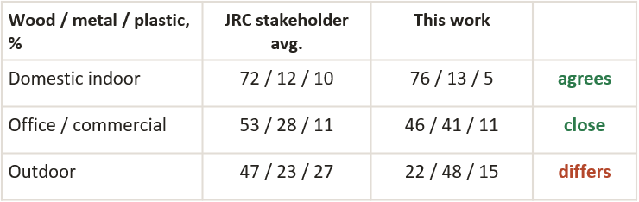
Comparison of results against other data
Tonnages agree with measured references; compositions agree for indoor furniture.
TONNAGES
COMPOSITIONS
20 Mt
Furniture put on market based on French data
45 kg per person in France, scaled to EU population including mattresses and textiles (Our estimate: 17.9 Mt excluding mattresses and textiles)
20 Mt
JRC103217 Table 14, stakeholder questionnaire averages (% by weight): wood / metal / plastic / other
+4%
Metal furniture production (31091100)
Estimated 1.13 Mt vs 1.09 Mt reported by Prodcom in kg; method range 0.73–1.55 Mt
+4%
Kitchen units
4.3 Mt vs 4.1 Mt from French EPR data (ADEME 2023, 9.2 kg per capita) scaled to EU27
France 2023, placed on market by majority material (ADEME 2024, Fig. 4), % of tonnage
Wood |  | 60,2%
Metal |  | 12,3%
Upholstered (rembourrés) |  | 10,2%
Mattresses |  | 2,8%
Plastic |  | 3,6%
Textiles |  | 1,5%
Other (inert, glass, wicker...) |  | 9,4%
67%
Panels in EU-made furniture
9.6 Mt vs 14.3 Mt implied by EPF panel statistics (high case 87%). EPF 'furniture' is broader, this comparison uses midpoint of panel board densities in Task 4, which may be in fact weighted differently by application
≈90%
Total in-scope furniture
17.9 Mt vs ≈20 Mt French EPR data scaled to EU27 (incl. mattresses and textiles)
170%
Total vs EEB/Eunomia (2017)
17.9 Mt vs ≈10.5 Mt: older top-down estimate, not built from trade masses
Houdus C., ADEME (2024)
Filière des éléments d'ameublement - Données 2023. Bilan annuel. FR placed on market 3,057,110 t / 568 m items; majority-material split (Fig. 4); tonnage by regulatory category CAT01-12 (Fig. 3). https://librairie.ademe.fr/

Slide 128
Proposed Base Cases
Material composition per category (% by mass, all segments)
Category | Avg unit mass (kg) | Solid wood | Wood-based panels | Steel | Aluminium | Other metals | Rigid plastics | PU foam | Texiles and coverings | Bamboo, rattan, cane | Glass | Other (adhesive, coating)
Seating – upholstered | 34,2 | 46,0% | 8,3% | 11,7% | 0,4% | 0,0% | 6,3% | 11,4% | 10,2% | 0,0% | 0,0% | 5,7%
Seating – non-upholstered | 5,4 | 19,8% | 0,0% | 25,1% | 12,2% | 0,2% | 38,1% | 0,1% | 0,0% | 0,7% | 0,0% | 3,9%
Storage unit | 40,8 | 6,8% | 65,2% | 22,0% | 0,1% | 0,0% | 2,9% | 0,0% | 0,0% | 0,1% | 1,5% | 1,6%
Office chair | 16,1 | 0,0% | 5,7% | 38,2% | 5,3% | 0,1% | 33,1% | 9,2% | 4,6% | 0,0% | 0,0% | 3,9%
Table | 22,1 | 21,1% | 27,6% | 27,2% | 7,9% | 0,0% | 3,8% | 0,0% | 0,0% | 0,3% | 8,6% | 3,6%
Bed (frame + base, excl. mattress) | 55,5 | 37,8% | 33,2% | 19,6% | 0,0% | 0,0% | 2,8% | 1,8% | 2,7% | 0,0% | 0,0% | 2,2%
Kitchen | 26,6 | 0,1% | 97,4% | 0,9% | 0,0% | 0,0% | 0,9% | 0,0% | 0,0% | 0,0% | 0,0% | 0,7%
Segments considered: domestic, commercial, outdoor

Slide 129
What the average kilogram is made of
Base case per category, % by mass, all segments, packaging excluded. EU27 apparent consumption 2021–24.
EU27 kt/yr
Total 17,937 (13,651–22,223)
4,266 Kitchens
5,423 Storage
3,704 Tables
2,146 Upholstered seating
1,242 Beds
756 Non-upholstered seating
400 Office chairs
Notes:
Kitchens 97% panels; storage 65% panels, 22% steel; office chairs 38% steel, 33% plastics. Beds rest entirely on engineering estimates (Low confidence).

Slide 130
Proposed Base Cases – Polymer composition
Category | Coverage of category plastics | PA | PP | ABS | POM | PE | PVC | Elastomers | Unspecified
Office chairs | 61% | 67% | 29% | 1% | 3% | 0% | 0% | 0% | 0%
Storage units | 51% | 1% | 16% | 76% | 0% | 0% | 0% | 0% | 7%
Seating, non-upholstered | 29% | 15% | 21% | 0% | 0% | 0% | 0% | 4% | 59%
Tables | 11% | 1% | 1% | 59% | 1% | 1% | 12% | 0% | 25%
Seating, upholstered | 9% | 9% | 25% | 1% | 2% | 0% | 0% | 0% | 63%

Slide 131
Questions
Q1. Classification of furniture products. Is the classification by product function and application/segment an appropriate way to structure the furniture product group? Are there any subcategories that should be added, removed, merged, split or defined differently?
Q2. Classification of furniture products. Are the assumed percentage splits of mixed CN codes (slide 113) across furniture categories plausible and representative of the EU market? Please indicate any shares that should be revised and provide alternative estimates or supporting evidence where available.
Q3 Representativeness of the identified product categories. Do the market shares, product masses and material compositions identified for the main products tfurniture products represent products currently placed on the EU market? Please indicate any material categories or product type that appear under or overrepresented.
Q4. Kitchens. Should kitchen furniture be considered as a separate category, or can it be integrated into the existing storage and table subcategories? Please indicate whether kitchen furniture presents specific design, material, performance or use-related characteristics that would justify separate Base Cases, and which distinguishing elements should be taken into account.

Slide 132
How to provide us data
Please provide data/quantification to substantiate comments (not just: number is wrong).
By mass, segment and coverage is most helpful
Also typical bill of materials
Bed type | Domestic | Commercial | Unit / basis
Panel / solid-wood frame | … | … | t or % of t; e.g. sales 2023, EU, ~40% coverage
Box-spring / upholstered base | … | …
Metal frame | … | …
Domestic and outdoor product BOMs
Bed composition and hotel share
Kitchen composition and commercial share
Production tonnage by category and
Placed on market by function

Slide 133
Annex: trade data used
32 CN codes in 18 Prodcom groups; EU27 apparent consumption 2021–24, kt/yr (central case).
CN | Prodcom | Content | kt/yr | Allocated to
9401.31/.39 | 31001150 | Swivel seats | 400 | Office chairs
9401.41/.49 | 31001210 | Seats convertible into beds | 424 | Uph. seating (sofas)
9401.52/.59 | 31001230 | Seats of bamboo, cane | 6 | Non-uph. seating
9401.61 | 31001250 | Upholstered seats, wooden frame | 1,193 | Uph. seating
9401.69 | 31001290 | Other seats, wooden frame | 161 | Non-uph. seating
9401.71 | 31001170 | Upholstered seats, metal frame | 529 | Uph. seating
9401.79 | 31001190 | Other seats, metal frame | 471 | Non-uph. seating
9401.80 | 31001300 | Other seats n.e.s. (plastic) | 119 | Non-uph. seating
9403.10.51 | 31011100 | Metal office desks | 145 | Tables
9403.10.58 | 31011100 | Metal office furniture ≤ 80 cm | 81 | Storage / tables
9403.10.91/.93/.98 | 31011100 | Metal office cupboards, filing, other > 80 cm | 264 | Storage
9403.30.11 | 31011200 | Wooden office desks | 615 | Tables
CN | Prodcom | Content | kt/yr | Allocated to
9403.30.19 | 31011200 | Wooden office furniture ≤ 80 cm | 373 | Storage / tables
9403.30.91/.99 | 31011200 | Wooden office cupboards, other > 80 cm | 318 | Storage
9403.20.20 | 31091100 | Metal beds | 117 | Beds
9403.20.80 | 31091100 | Other metal furniture | 1,818 | Storage / tables / outdoor
9403.40.10/.90 | 31021000 | Kitchen furniture (fitted, other) | 4,266 | Kitchens
9403.50 | 31091230 | Wooden bedroom furniture | 2,266 | Storage / beds
9403.60.10 | 31091250 | Wooden dining / living-room | 2,525 | Storage / tables
9403.60.90 | 31091300 | Other wooden furniture | 2,221 | Storage / tables / outdoor
9403.70 | 31091430 | Furniture of plastics | 167 | Storage / tables / outdoor
9403.82/.83 | 31091450 | Furniture of bamboo, rattan | 18 | Natural-fibre archetypes
9403.89 | 31091450 | Furniture of other materials | 106 | Glass / metal tables, cabinets
9404.10 | 31031100 | Mattress supports (bases) | 445 | Beds
Not included: wooden shop furniture (9403.60.30, Prodcom 31011300), mattresses (9404.2x), medical furniture (9402), furniture parts (9403.9x), vehicle seats (9401.10–.20). Metal shop furniture sits in 9403.20.80; its share is booked as out of scope.

Slide 134
Annex: product data used
Study EPD collected base data (cleaned) feed 12 archetypes through 11 groups; published EPDs and literature feed the rest.
196
EPDs in the study's
base tables
EPD group | EPDs used | Non-EU excl. | Manufacturers | Largest maker | Feeds archetype
Wood-based storage | 23 | 1 | 4 | 19 of 23 | Flat-pack storage; wood office storage
Metal-based storage | 13 | 2 | 4 | 7 of 13 | Steel office storage
Dining / meeting table, panel | 13 | 0 | 6 | 5 of 13 | Panel dining table
Dining table, solid wood | 3 | 1 | 2 | 2 of 3 | Solid-wood dining table
Coffee table, wood-based | 3 | 0 | 3 | 1 of 3 | Coffee table
Desks (wood, metal, mixed) | 12 | 5 | 9 | 2 of 12 | Office desk
Task chair, ≥ 10% aluminium | 11 | 7 | 5 | 6 of 11 | Contract task chair
Task chair, < 10% aluminium | 5 | 7 | 3 | 2 of 5 | Mid-range task chair
Visitor / multipurpose, upholstered | 12 | 2 | 5 | 5 of 12 | Visitor chair
Sofas | 5 | 1 | 2 | 4 of 5 | Contract sofa
Multipurpose chair, non-uph. | 6 | 3 | 6 | 1 of 6 | Stacking chair
186
with usable material
lines after cleaning
106
used in groups (EU27,
EFTA, UK made)
1,445
material lines
Other product sources Published EPDs: 12 from 7 manufacturers (office chairs, upholstered seating, wooden chairs, kitchen units) · Yang et al. 2025: 25 pieces · Aggarwal et al. 2026: sofa · JRC103217 Table 22 averages · 18 archetypes on engineering estimates (beds, outdoor, budget office chairs, metal/plastic storage, glass and natural-fibre items).
Not used from the study 51 EPDs: beds (healthcare), m² workstations, 16-variant textile-top table, specialised storage, stools, benches, lounge chairs.
Red = one manufacturer supplies half the group or more.

Slide 135
Preparatory Study: DPP Aspects

Slide 136
DPP content analysis
DPP: Digital Product Passport
Objective, tasks & method
The objective is to defining data (content) requirements for the DPP under the ESPR framework
DPP system not in scope; Step A is not intended to define the final DPP content.
Step A “Scope and context”
A1/A2: what is in scope, who is involved,
A3: what is already required
A4: What is practiced
Completed
1. Consultation (survey)
Step B “Use cases and data needs”
Specify & validate use-case
Derive data needs
Draft
2. Consultation
Step C “Technical data specifications”
Granularity, access, governance, vocabularies
Next
Step D “Verification of proposed DPP requirements”
JRC step | Work performed
A.1 Define product scope | Aligned to the furniture scope of the main preparatory study; no separate DPP product scope
A.2 Market context & stakeholders | Mapped furniture value chain and relevant actors from raw materials to end-of-life
A.3 Policy & legal context | Reviewed ESPR, other Union law, voluntary schemes and existing systems
A.4 Data collection status quo | Reality check: availability, formats, granularity, verification and barriers
Notes:
JRC step
Work performed
A.1 Define product scope
Aligned to the furniture scope of the main preparatory study; no separate DPP product scope
A.2 Market context & stakeholders
Mapped furniture value chain and relevant actors from raw materials to end-of-life
A.3 Policy & legal context
Reviewed ESPR, other Union law, voluntary schemes and existing systems
A.4 Data collection status quo
Reality check: availability, formats, granularity, verification and barriers
Objective
A1Define the product group to which the DPP specification applies
A2Understand the value chain, key actors, data roles and exchange points
A3Identify existing mandatory/voluntary disclosures and opportunities to reuse existing systems rather than duplicate reporting
A4Reality check: what data exist, how they are collected/shared/verified, at what granularity and with which barriers

Slide 137
Task A.1 & A.2: What is in scope, who is involved
DPP
Product scope; Market context & stakeholders
Product scope aligned to main study
  ESPR (generic DPP requirements) / DA: furniture specific DPP requirements
Stakeholder scope:
Value chain stage | Representative stakeholders
Raw material supply/extraction | Wood/timber, fibre, metal and chemical raw-material suppliers/ producers
Intermediate materials and components | Panel, textile, leather, foam, plastics, metal, glass, chemical and fittings suppliers
Design and product development | Brands, designers, product developers
Furniture manufacturing | Manufacturers, OEMs, contract manufacturers, SMEs and craft producers
Finishing, quality control and packaging | Finishing operators, testing bodies, quality-control and packaging providers
Distribution and logistics | Importers, distributors, logistics providers, warehouses, fulfilment providers
Wholesale and retail | Wholesalers, retailers, online retailers and marketplaces
Use phase and after-sales services | Consumers, professional users, manufacturers and retailers
Repair and maintenance | Independent repairers, upholsterers, service networks
Secondary market, reuse, refurbishment | Second-hand platforms, reuse organisations, refurbishers, take-back operators
End-of-life management and recycling | PROs, collectors, waste operators, sorters, dismantlers and recyclers
Market surveillance and customs authorities | National market surveillance authorities and customs authorities

Slide 138
Task A.3: What is already required
REACH: Regulation on Registration, Evaluation,
Authorization and Restriction of Chemicals
CLP: Classification, Labelling and Packaging of
substances and mixtures
GPSR: General Product Safety Regulation
PPWR: Packaging and Packaging Waste Regulation
WFD: Waste Framework Directive
EPR: Extended Producer Responsibility
EUDR: EU Deforestation Regulation
TLR: Textile Labelling Regulation
CPR: Construction Products Regulation
BPR: Biocidal Products Regulation
CITES: Convention on International Trade in Endangered
Species of Wild Fauna and Flora
POPs: Stockholm Convention on Persistent Organic Pollutants
Review ESPR & other legal acts
Hazardous properties of chemicals
EU
legal acts
Chemicals
Trade
International legal acts
CLP 1272/2008/EC
Materials
Biocidal products
REACH 1907/2006/EC
CITES
POPs
BPR No. 528/2012, Art. 58
Furniture sector
Deforestation
EUDR 2023/1115/EU
Right to repair dir. 2024/1799/EU
Reparability
GPSR 2023/988/EU
Packaging Dir. 94/62/EC
& PPWR 2025/40/EU
Reuse of waste
Product safety
CPR 2024/3110/EU
WFD 2008/98/EC, incl. EPR
TLR 1007/2011/EU
Performance & safety of construction products
Waste management
Labelling of compositions

Slide 139
Task A.3: What is already required
DPP
Review policy & legal context: ESPR
Category | Information requirements | Level of disclosure
Product and producer identification | Unique product identifier; Global Trade Identification Number (GTIN) or equivalent; relevant commodity codes, such as a TARIC code | Product
 | Information related to the manufacturer, such as its unique operator identifier; unique operator identifiers other than that of the manufacturer; unique facility identifiers | Operator / facility
 | Information related to the importer, including EORI number; name, contact details and unique operator identifier of the economic operator established in the Union responsible for the product | Operator
Product-specific information | Information on the performance of the product in relation to one or more of the product parameters referred to in Annex I, including a repairability score, durability score, carbon footprint or environmental footprint | Customer / other actors
 | Information on how to install, use, maintain and repair the product; collection for refurbishment or remanufacture; how to return or handle the product at end-of-life | Customers / other actors
 | Information for treatment facilities on disassembly, reuse, refurbishment, recycling, or disposal at end-of-life | Treatment facilities
Information on substances of concern | SoC name or numerical code; location within the product; concentration, maximum concentration or concentration range of substances of concern | Product / components
 | Instructions for the safe use of the product; information for disassembly, preparation for reuse, reuse, recycling and environmentally sound management at end-of-life | Users / treatment facilities
Information requirements under other Union law | Information required by other Union law; compliance documentation and information (declaration of conformity, technical documentation); manuals, warnings, safety info. | Product / documentation

Slide 140
Task A.4 (survey findings): What is practiced
DPP
Data-collection status quo
Respondents by stakeholder type
Stakeholder type | Respondents | Share
Furniture manufacturers and retailers | 9 | 20%
Industry and trade associations | 10 | 22%
Materials and component suppliers | 6 | 13%
Public authorities | 6 | 13%
Environmental NGOs and networks | 4 | 9%
Testing, certification and standards bodies | 3 | 7%
Research, academia and consultancy | 3 | 7%
Consumer organisations | 2 | 4%
Producer responsibility organisation (EPR) | 1 | 2%
Not identified | 2 | 4%
Total | 46 | 100%
Table 2: Response rate by question
Question | Respones
Q11 - DPP information needs | 45 / 46
Q2 - Data-providing actors & data availability | 9 / 46
Q3a - Data gaps | 9 / 46
Q3b - Data standards used | 26 / 46
Q3c - Data collection and sharing format | 13 / 46
Q3d - Data quality and granularity | 11 / 46
Q3e - Verification mechanisms | 21 / 46
Q3f - Barriers to data collection | 13 / 46

Slide 141
Task A.4 (survey findings): What is practiced
DPP
Data-collection status quo
DPP aspects that were evaluated in stakeholder survey:
Data availability, gaps / needs → Use cases with data needs
Barriers to data collection/sharing → Readiness to provide missing data
Data formats and digitalisation
Standards and classifications
Granularity and data quality
Verification mechanisms
A use case clarifies why / for which purpose DPP information is needed.
Notes:
Relevant to evaluate readiness
Become further relevant after relevant use cases are identified

Slide 142
Task B.1: Use cases for consumers (B2C information)
DPP
Use case | Identified information need | Readiness | Question / evaluation
Inform sustainable purchasing decisions | Consumers need information on durability/expected lifetime, warranty conditions, maintenance and replaceability (of components) | Circularity information (durability, repairability) less available | Which information influences purchasing decisions and should be provided through the DPP? → MEErP Task 1 & 3
Maintaining furniture appropriately | Care and maintenance information | Existing but not always standardised or persistently accessible | -
Self-repair of furniture | Need for repair instructions, component information, spare-part availability/compatibility and disassembly information; | information available but partially incomplete or fragmented | Which information can realistically be made available to consumers, and at what level of detail?
Finding repair or reupholstery services | General need for repair options and better repair information identified | local/independent services are fragmented and can change frequently | Is this a relevant DPP use case? Should the DPP contain service information or link to external/local services?
Take-back and disposal guidance | Need for take-back, reuse, separate collection and disposal information. | local/EPR information varies geographically and can change | Should the DPP contain this information directly or mainly link to local/EPR systems?

Slide 143
Task B.1: Use cases for businesses (B2B information)
DPP
Use case | Identified information need | Readiness | Question / evaluation
Repairer: B2B repair and spare-part sourcing | Repair/refurbishment requires on component-level: joining methods, spare-part identifiers/compatibility, disassembly and repair/refurb history | BoMs, specifications and some spare-part data exist; component-level data + repair/refurb history incomplete/n.a. | Can this information realistically be provided at component level? How difficult is item-level repair/history tracking?
Reuse: B2B second-hand resale | Secondary-market actors need product identification, description and condition verified product condition/history, repair information and product characteristics | product information exist; condition and item history are rarely recorded | Do information adds real value beyond basic product identification?
Leasing, refurbishment, remanufacturing and asset management | Stakeholders identified a need for item-level information on repair & refurbishment history, component replacement and condition | item-level lifecycle data are currently uncommon & not systematically recorded | Is collecting and updating item-level lifecycle information feasable and relevant?
Recycling: Sorting and disassembly | End-of-life actors need material composition, substances of concern and joining/disassembly methods to determine appropriate reuse, dismantling and recycling routes | some material/chemical information exists, but information is not transferred to end-of-life operators | Would operators access and use DPP information in operational sorting/dismantling/recycling?

Slide 144
Next steps in the DPP content analysis
DPP
Based on the use-cases, the next steps will determine:
  Priority data needs
  Granularity (model, batch, item)
  Access & governance
  Verification
Other use cases to be verified on “compliance check & monitoring”

Slide 145
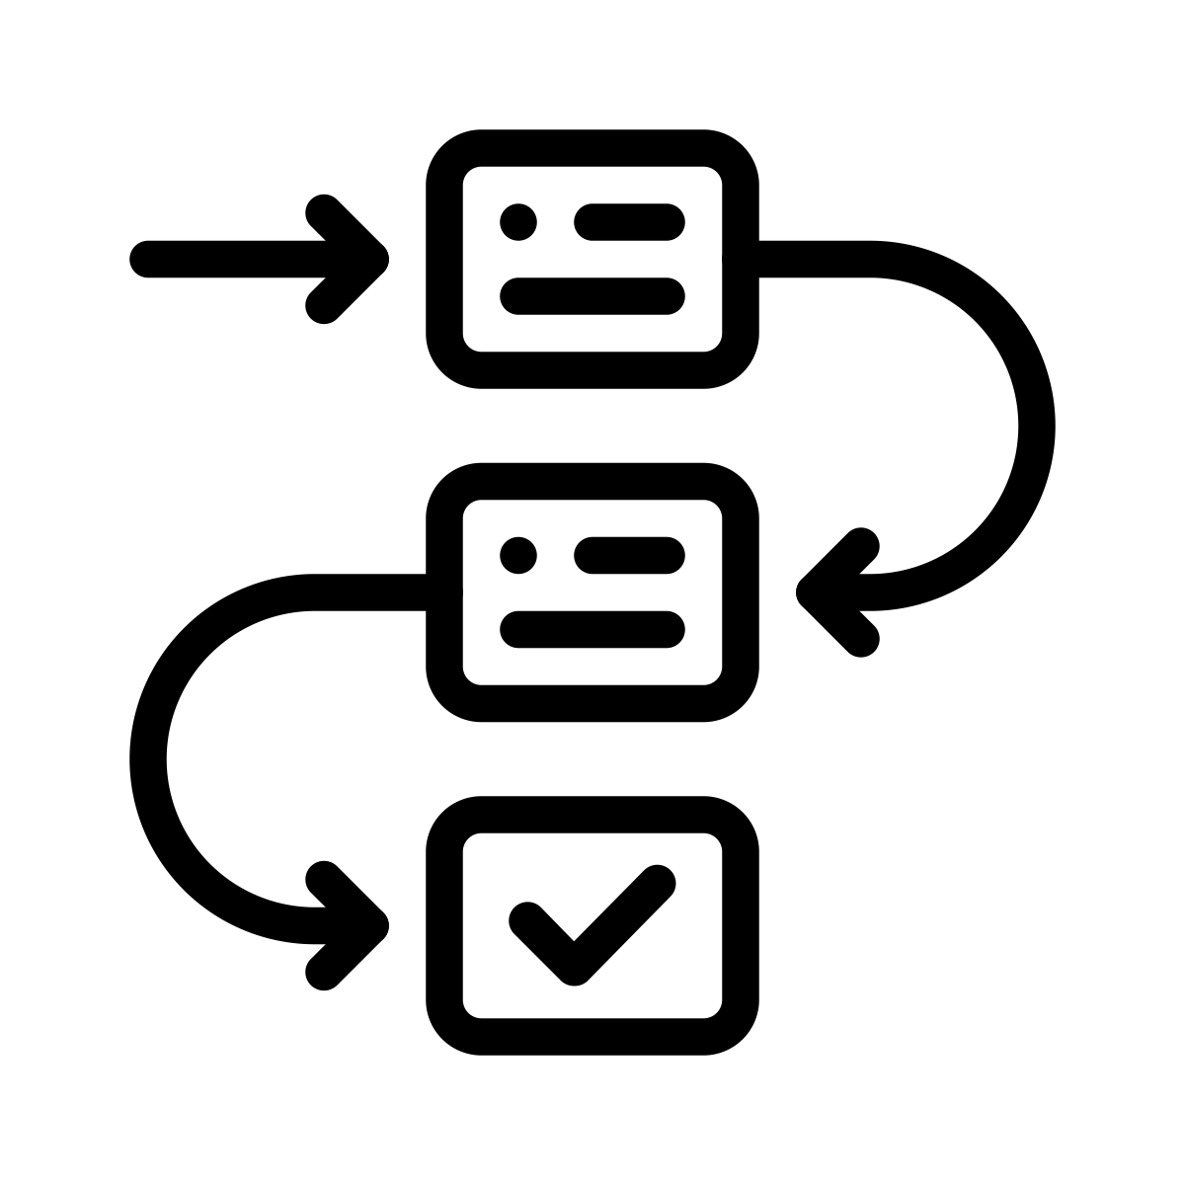
Next Steps
Trinomics

Slide 146
Next steps in the coming weeks
Preparatory study, Phase I to Phase II
Further processing of stakeholder input received so far, including on LCA data and substances of concern
Feedback from stakeholders by 3 November to confirm assumptions and close data gaps in Tasks 1–4, and revision of the report where relevant (v2 in January 2027)
Finalisation of data sets relating to the Base Cases in Task 5
  Confirmation of candidate Base Cases (such as kitchen furniture, wooden dining and living room furniture, upholstered seats and metal furniture)
  Updated BoMs and other product parameters outlined in Task 4, including manufacturing energy, packaging and end-of-life scenarios
  Realistic assumptions on typical use and actual first-user lifetimes
Preparation of the Substances of Concern report to accompany Task 5

Slide 147
Next steps
Preparatory study stages after today’s meeting
Oct–Nov 2026
Jan 2027
Feb 2027
Mar 2027
Spring 2027
PHASE I
Tasks 1–4
Stakeholder feedback
Comments on Task 1–4 reports by 3 Nov
Targeted contacts on manufacturing processes and products
Task 1–4 report v2
Revised report published, taking stakeholder input on board
FINAL
Preparatory study completed
Tasks 1–7 finalised
PHASE II
Tasks 5–7
Work on Tasks 5–7 starts in October
2nd stakeholder meeting
Discussion of Tasks 5–7
Task 5
Environment & economics
Task 6
Design options
Task 7
Scenarios
Interim draft
Task 5–7 reports for comments
How to contribute: send your comments on the Task 1–4 reports by 3 November 2026 via the feedback form in the Project website.

Slide 148
Closing remarks
DG ENV
Trinomics
VITO

